Slide 1

Intelligent Optimization in Chemical Engineering
Hua Zhou
cezhouh@xmu.edu.cn
11/20/2024
College of Chemistry & Chemical Engineering

Slide 2

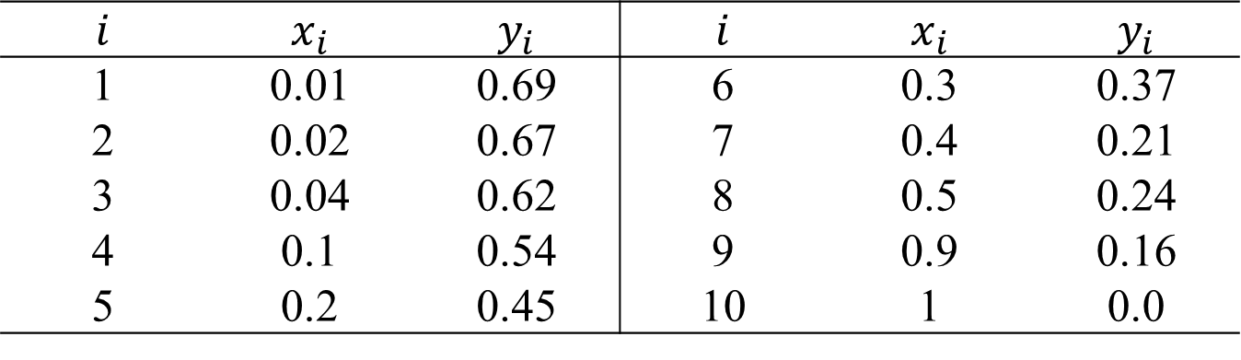
最小二乘(高斯牛顿法)
Case 1
利用吉利兰关联图拟合得到数学模型，图横坐标为自变量$x=\frac{R−R_{min}}{R+1}$，纵坐标为因变量$y=\frac{N−N_{min}}{N+2}$，关联图上取若干个点$\left(x_{i},y_{i}\right)$，每一个$x_{i}$均有一个$y_{i}$与之对应，数据如表所示。
$$i$$ | $$x_{i}$$ | $$y_{i}$$ | $$i$$ | $$x_{i}$$ | $$y_{i}$$
1 | 0.01 | 0.69 | 6 | 0.3 | 0.37
2 | 0.02 | 0.67 | 7 | 0.4 | 0.21
3 | 0.04 | 0.62 | 8 | 0.5 | 0.24
4 | 0.1 | 0.54 | 9 | 0.9 | 0.16
5 | 0.2 | 0.45 | 10 | 1 | 0.0

Slide 3
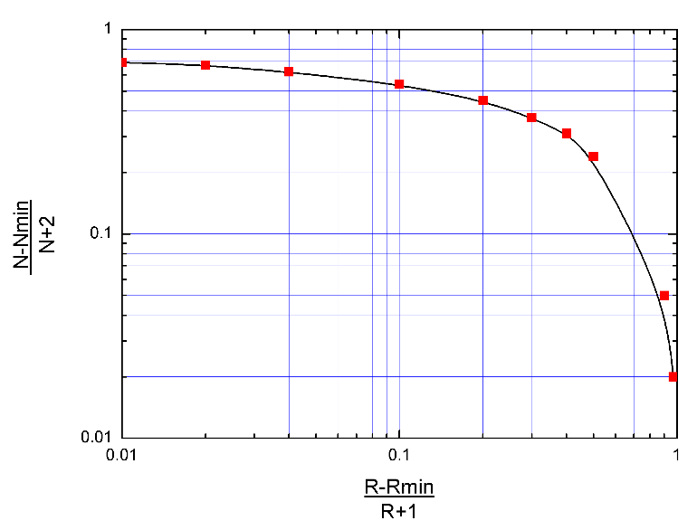
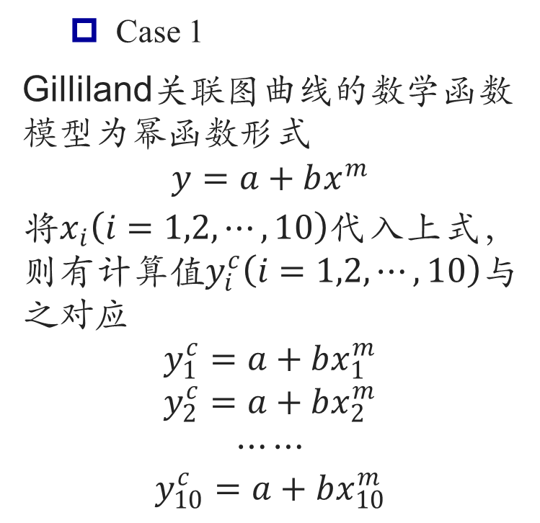

最小二乘(高斯牛顿法)
Case 1
Gilliland关联图曲线的数学函数模型为幂函数形式
$$y=a+bx^{m}$$
将$x_{i}\left(i=1,2,⋯,10\right)$代入上式，则有计算值$y_{i}^{c}\left(i=1,2,⋯,10\right)$与之对应
$$y_{1}^{c}=a+bx_{1}^{m}$$
$$y_{2}^{c}=a+bx_{2}^{m}$$
$$⋯⋯$$
$$y_{10}^{c}=a+bx_{10}^{m}$$
确定参数$a,b,m$可得到相应的模型，为了确保拟合的函数即数学模型能更好的反映实验数据，设计一个平方和函数来评价该拟合函数，即将计算值$y_{i}^{c}\left(i=1,2,⋯,10\right)$与实验值$y_{i}\left(i=1,2,⋯,10\right)$相减的平方和作为评价指标，即

Slide 4
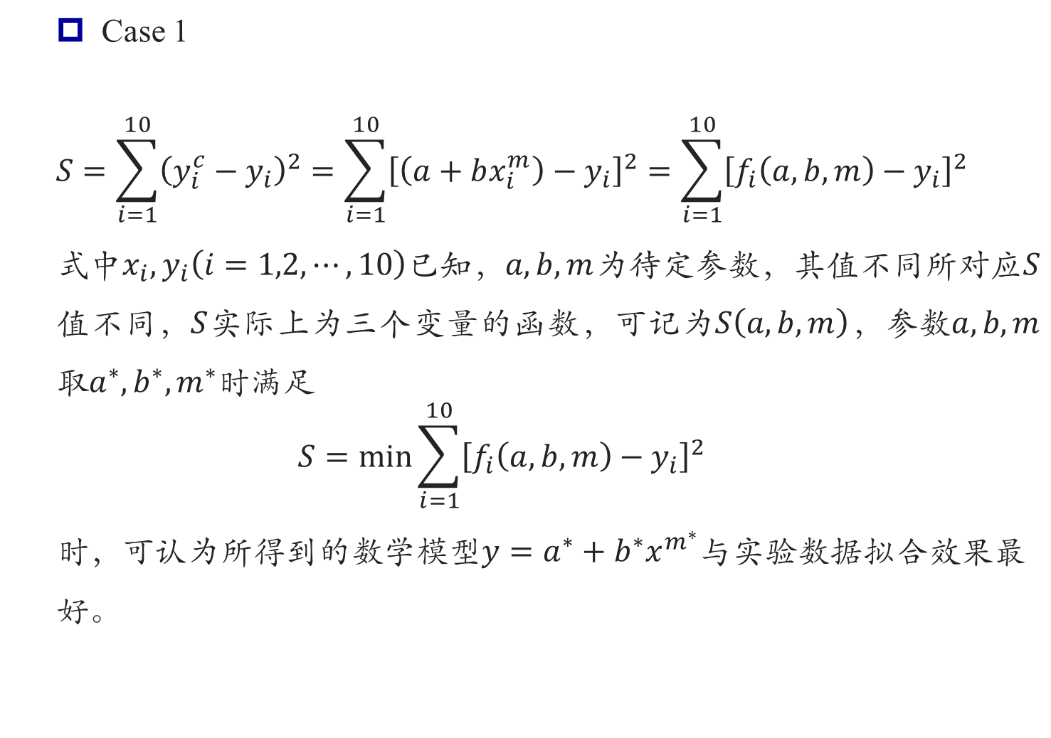
最小二乘(高斯牛顿法)
Case 1
$$S=\sum_{i=1}^{10}{{\left(y_{i}^{c}−y_{i}\right)}^{2}}=\sum_{i=1}^{10}{{\left[\left(a+bx_{i}^{m}\right)−y_{i}\right]}^{2}}=\sum_{i=1}^{10}{{\left[f_{i}\left(a,b,m\right)−y_{i}\right]}^{2}}$$
式中$x_{i},y_{i}\left(i=1,2,⋯,10\right)$已知，$a,b,m$为待定参数，其值不同所对应$S$值不同，$S$实际上为三个变量的函数，可记为$S\left(a,b,m\right)$，参数$a,b,m$取$a^{∗},b^{∗},m^{∗}$时满足
$$S=\min{\sum_{i=1}^{10}{{\left[f_{i}\left(a,b,m\right)−y_{i}\right]}^{2}}}$$
时，可认为所得到的数学模型$y=a^{∗}+b^{∗}x^{m^{∗}}$与实验数据拟合效果最好。

Slide 5
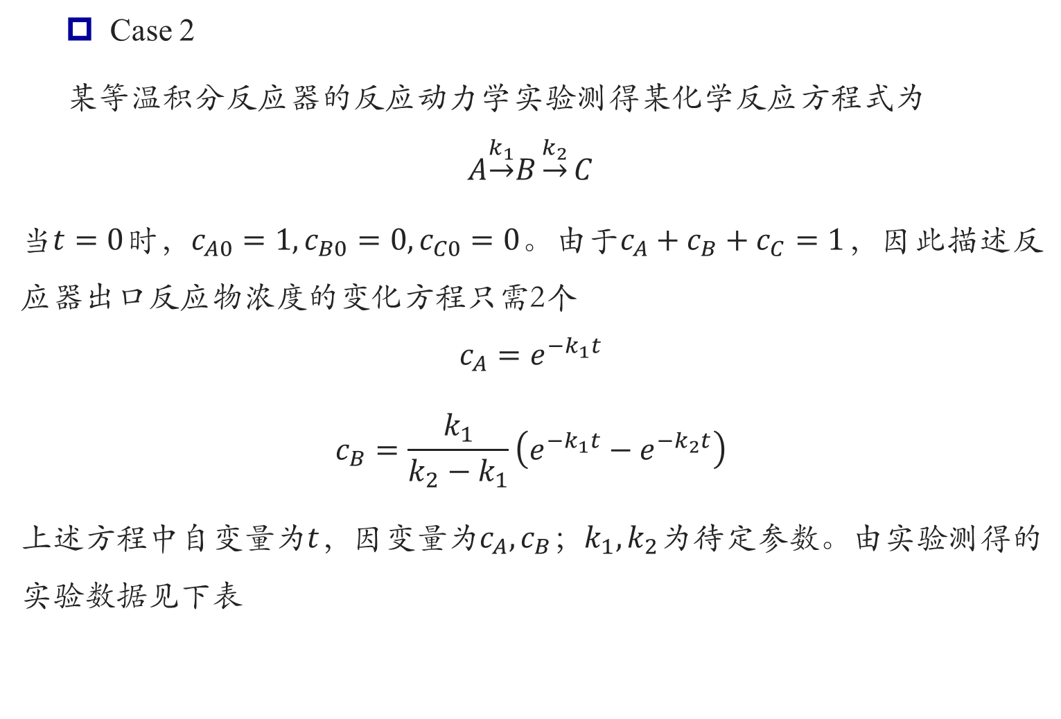
最小二乘(高斯牛顿法)
Case 2
某等温积分反应器的反应动力学实验测得某化学反应方程式为
$$A\underset{→}{k_{1}}B\underset{→}{k_{2}}C$$
当$t=0$时，$c_{A0}=1,c_{B0}=0,c_{C0}=0$。由于$c_{A}+c_{B}+c_{C}=1$，因此描述反应器出口反应物浓度的变化方程只需2个
$$c_{A}=e^{−k_{1}t}$$
$$c_{B}=\frac{k_{1}}{k_{2}−k_{1}}\left(e^{−k_{1}t}−e^{−k_{2}t}\right)$$
上述方程中自变量为$t$，因变量为$c_{A},c_{B}$；$k_{1},k_{2}$为待定参数。由实验测得的实验数据见下表

Slide 6

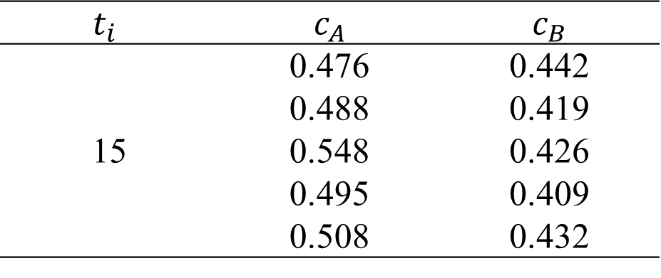
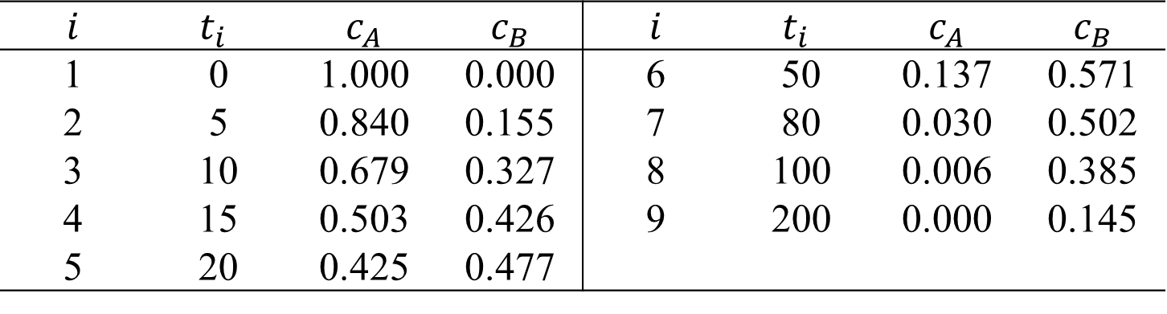
最小二乘(高斯牛顿法)
Case 2
当$t=15$时，重复实验测得数据如下
$$i$$ | $$t_{i}$$ | $$c_{A}$$ | $$c_{B}$$ | $$i$$ | $$t_{i}$$ | $$c_{A}$$ | $$c_{B}$$
1 | 0 | 1.000 | 0.000 | 6 | 50 | 0.137 | 0.571
2 | 5 | 0.840 | 0.155 | 7 | 80 | 0.030 | 0.502
3 | 10 | 0.679 | 0.327 | 8 | 100 | 0.006 | 0.385
4 | 15 | 0.503 | 0.426 | 9 | 200 | 0.000 | 0.145
5 | 20 | 0.425 | 0.477
$$t_{i}$$ | $$c_{A}$$ | $$c_{B}$$
15 | 0.476 | 0.442
 | 0.488 | 0.419
 | 0.548 | 0.426
 | 0.495 | 0.409
 | 0.508 | 0.432

Slide 7
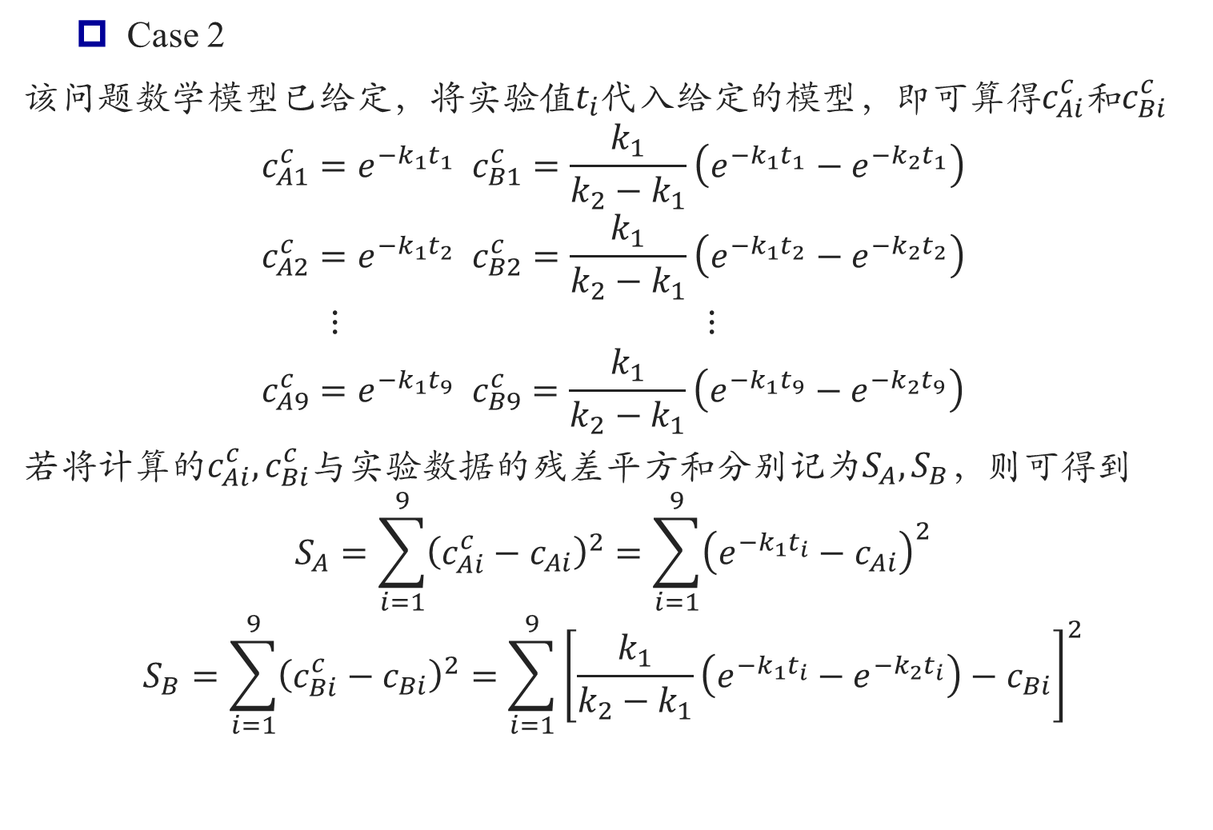
最小二乘(高斯牛顿法)
Case 2
该问题数学模型已给定，将实验值$t_{i}$代入给定的模型，即可算得$c_{Ai}^{c}$和$c_{Bi}^{c}$
$$c_{A1}^{c}=e^{−k_{1}t_{1}} c_{B1}^{c}=\frac{k_{1}}{k_{2}−k_{1}}\left(e^{−k_{1}t_{1}}−e^{−k_{2}t_{1}}\right)$$
$$c_{A2}^{c}=e^{−k_{1}t_{2}} c_{B2}^{c}=\frac{k_{1}}{k_{2}−k_{1}}\left(e^{−k_{1}t_{2}}−e^{−k_{2}t_{2}}\right)$$
$$⋮ ⋮$$
$$c_{A9}^{c}=e^{−k_{1}t_{9}} c_{B9}^{c}=\frac{k_{1}}{k_{2}−k_{1}}\left(e^{−k_{1}t_{9}}−e^{−k_{2}t_{9}}\right)$$
若将计算的$c_{Ai}^{c}, c_{Bi}^{c}$与实验数据的残差平方和分别记为$S_{A},S_{B}$，则可得到
$$S_{A}=\sum_{i=1}^{9}{{\left(c_{Ai}^{c}−c_{Ai}\right)}^{2}}=\sum_{i=1}^{9}{{\left(e^{−k_{1}t_{i}}−c_{Ai}\right)}^{2}}$$
$$S_{B}=\sum_{i=1}^{9}{{\left(c_{Bi}^{c}−c_{Bi}\right)}^{2}}=\sum_{i=1}^{9}{{\left[\frac{k_{1}}{k_{2}−k_{1}}\left(e^{−k_{1}t_{i}}−e^{−k_{2}t_{i}}\right)−c_{Bi}\right]}^{2}}$$

Slide 8
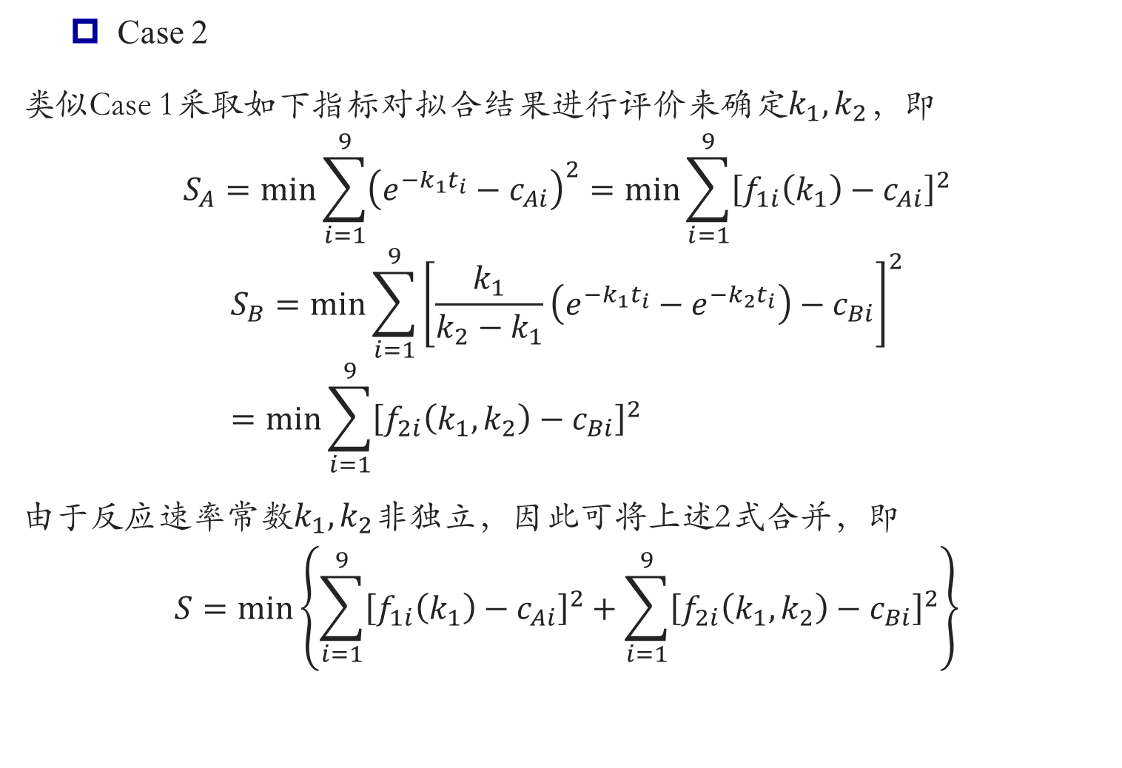
最小二乘(高斯牛顿法)
Case 2
类似Case 1采取如下指标对拟合结果进行评价来确定$k_{1},k_{2}$，即
$$S_{A}=\min{\sum_{i=1}^{9}{{\left(e^{−k_{1}t_{i}}−c_{Ai}\right)}^{2}}}=\min{\sum_{i=1}^{9}{{\left[f_{1i}\left(k_{1}\right)−c_{Ai}\right]}^{2}}}$$
$$S_{B}=\min{\sum_{i=1}^{9}{{\left[\frac{k_{1}}{k_{2}−k_{1}}\left(e^{−k_{1}t_{i}}−e^{−k_{2}t_{i}}\right)−c_{Bi}\right]}^{2}}}=\min{\sum_{i=1}^{9}{{\left[f_{2i}\left(k_{1},k_{2}\right)−c_{Bi}\right]}^{2}}}$$
由于反应速率常数$k_{1},k_{2}$非独立，因此可将上述2式合并，即
$$S=\min\left\{\sum_{i=1}^{9}{{\left[f_{1i}\left(k_{1}\right)−c_{Ai}\right]}^{2}}+\sum_{i=1}^{9}{{\left[f_{2i}\left(k_{1},k_{2}\right)−c_{Bi}\right]}^{2}}\right\}$$

Slide 9
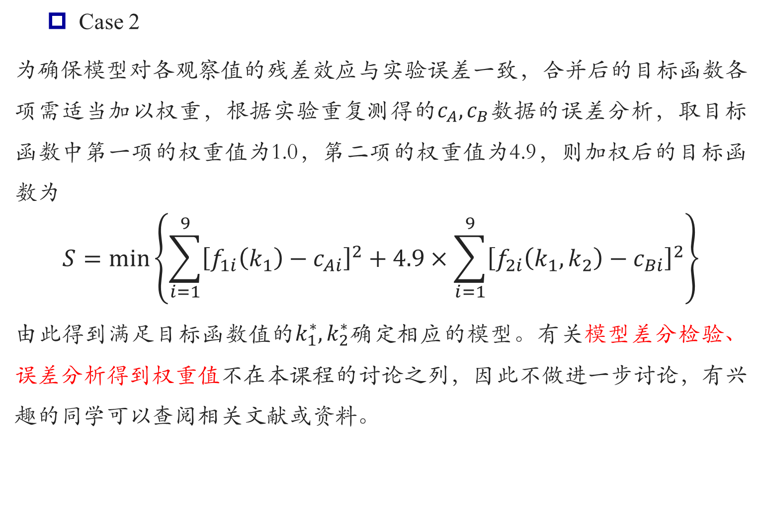
最小二乘(高斯牛顿法)
Case 2
为确保模型对各观察值的残差效应与实验误差一致，合并后的目标函数各项需适当加以权重，根据实验重复测得的$c_{A},c_{B}$数据的误差分析，取目标函数中第一项的权重值为1.0，第二项的权重值为4.9，则加权后的目标函数为
$$S=\min\left\{\sum_{i=1}^{9}{{\left[f_{1i}\left(k_{1}\right)−c_{Ai}\right]}^{2}}+4.9×\sum_{i=1}^{9}{{\left[f_{2i}\left(k_{1},k_{2}\right)−c_{Bi}\right]}^{2}}\right\}$$
由此得到满足目标函数值的$k_{1}^{∗},k_{2}^{∗}$确定相应的模型。有关模型差分检验、误差分析得到权重值不在本课程的讨论之列，因此不做进一步讨论，有兴趣的同学可以查阅相关文献或资料。

Slide 10
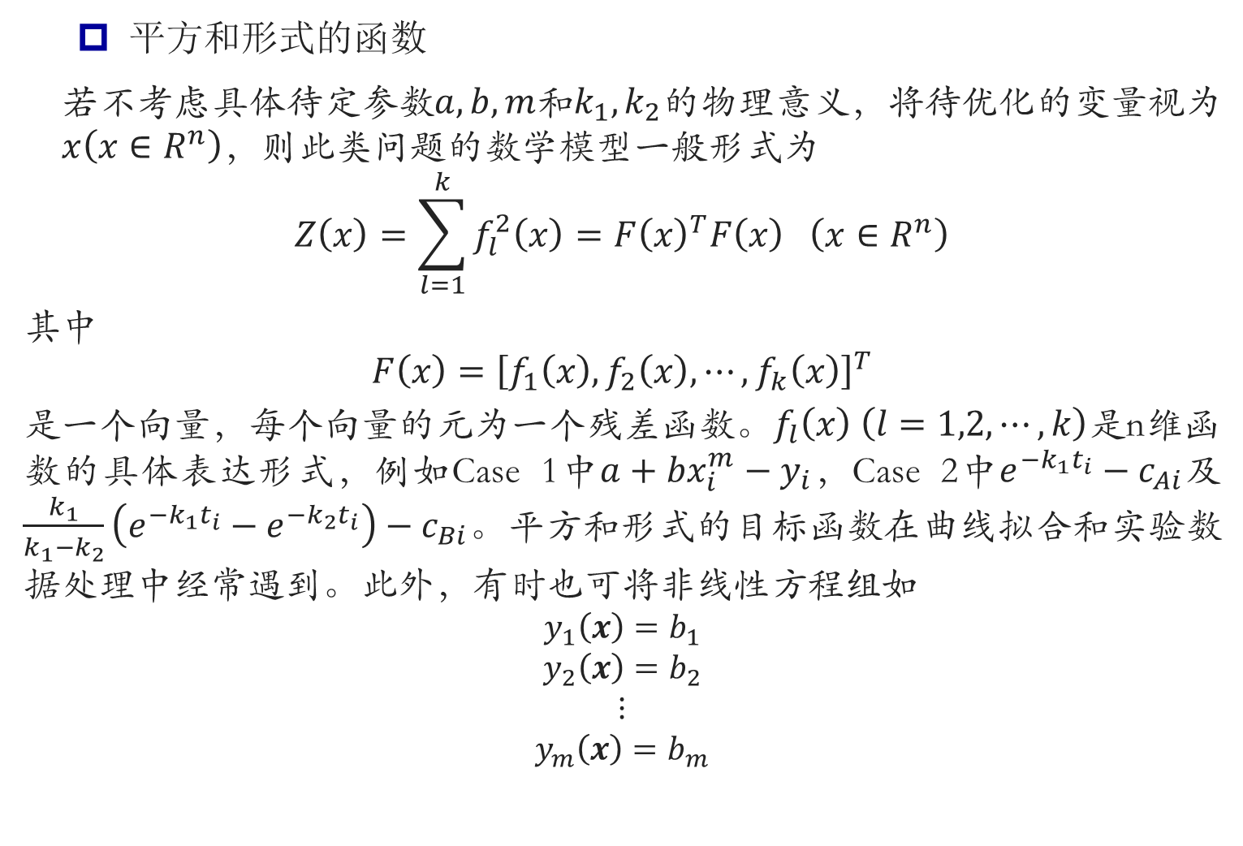
最小二乘(高斯牛顿法)
平方和形式的函数
若不考虑具体待定参数$a,b,m$和$k_{1},k_{2}$的物理意义，将待优化的变量视为$x\left(x∈R^{n}\right)$，则此类问题的数学模型一般形式为
$$Z\left(x\right)=\sum_{l=1}^{k}{f_{l}^{2}\left(x\right)}=F{\left(x\right)}^{T}F\left(x\right) \left(x∈R^{n}\right)$$
其中
$$F\left(x\right)={\left[f_{1}\left(x\right),f_{2}\left(x\right),⋯,f_{k}\left(x\right)\right]}^{T}$$
是一个向量，每个向量的元为一个残差函数。$f_{l}\left(x\right) \left(l=1,2,⋯,k\right)$是n维函数的具体表达形式，例如Case 1中$a+bx_{i}^{m}−y_{i}$，Case 2中$e^{−k_{1}t_{i}}−c_{Ai}$及$\frac{k_{1}}{k_{1}−k_{2}}\left(e^{−k_{1}t_{i}}−e^{−k_{2}t_{i}}\right)−c_{Bi}$。平方和形式的目标函数在曲线拟合和实验数据处理中经常遇到。此外，有时也可将非线性方程组如
$$y_{1}\left(x\right)=b_{1}$$
$$y_{2}\left(x\right)=b_{2}$$
$$⋮$$
$$y_{m}\left(x\right)=b_{m}$$

Slide 11
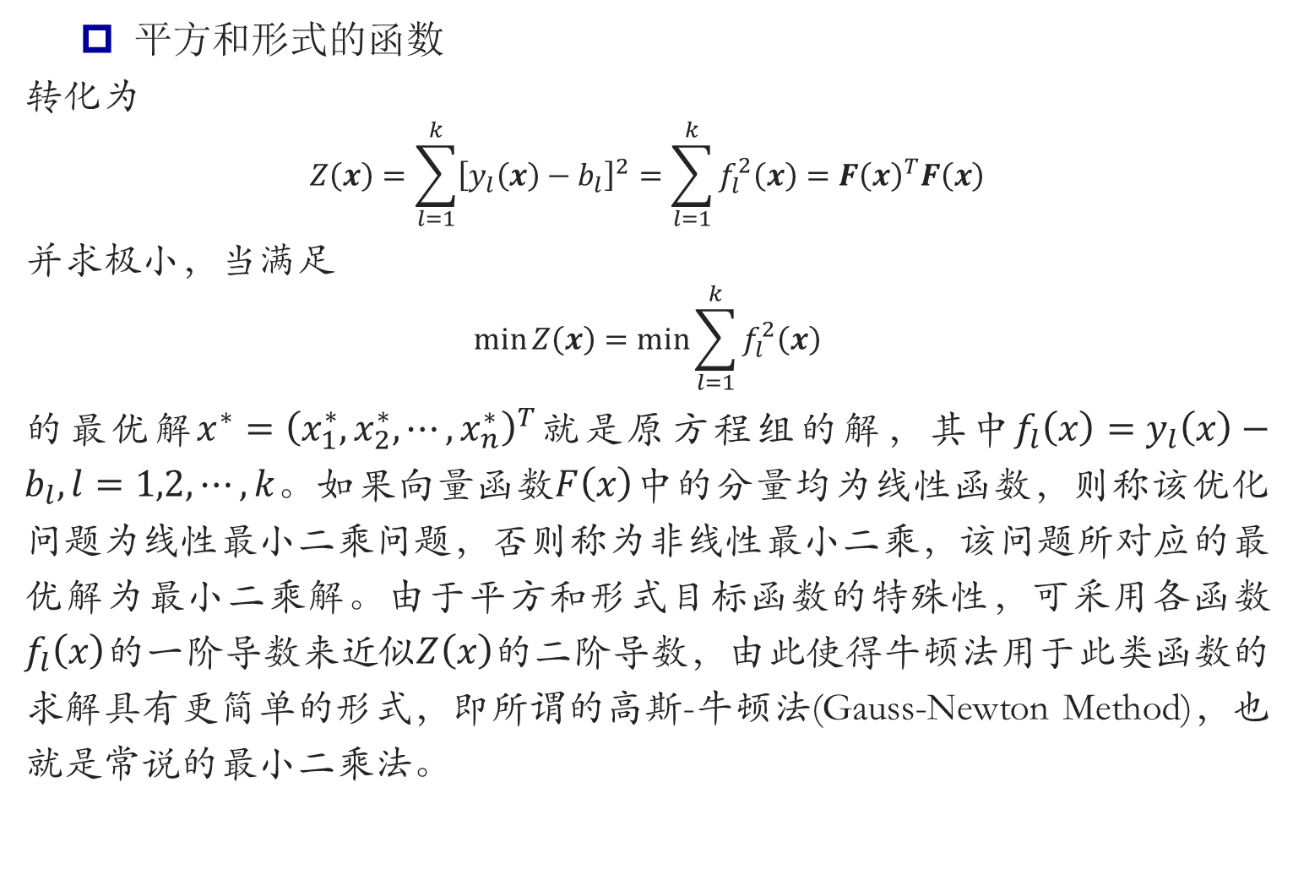
最小二乘(高斯牛顿法)
平方和形式的函数
转化为
$$Z\left(x\right)=\sum_{l=1}^{k}{{\left[y_{l}\left(x\right)−b_{l}\right]}^{2}}=\sum_{l=1}^{k}{f_{l}^{2}\left(x\right)}=F{\left(x\right)}^{T}F\left(x\right)$$
并求极小，当满足
$$\min{Z\left(x\right)=\min{\sum_{l=1}^{k}{f_{l}^{2}\left(x\right)}}}$$
的最优解$x^{∗}={\left(x_{1}^{∗},x_{2}^{∗},⋯,x_{n}^{∗}\right)}^{T}$就是原方程组的解，其中$f_{l}\left(x\right)=y_{l}\left(x\right)−b_{l}, l=1,2,⋯,k$。如果向量函数$F\left(x\right)$中的分量均为线性函数，则称该优化问题为线性最小二乘问题，否则称为非线性最小二乘，该问题所对应的最优解为最小二乘解。由于平方和形式目标函数的特殊性，可采用各函数$f_{l}\left(x\right)$的一阶导数来近似$Z\left(x\right)$的二阶导数，由此使得牛顿法用于此类函数的求解具有更简单的形式，即所谓的高斯-牛顿法(Gauss-Newton Method)，也就是常说的最小二乘法。

Slide 12
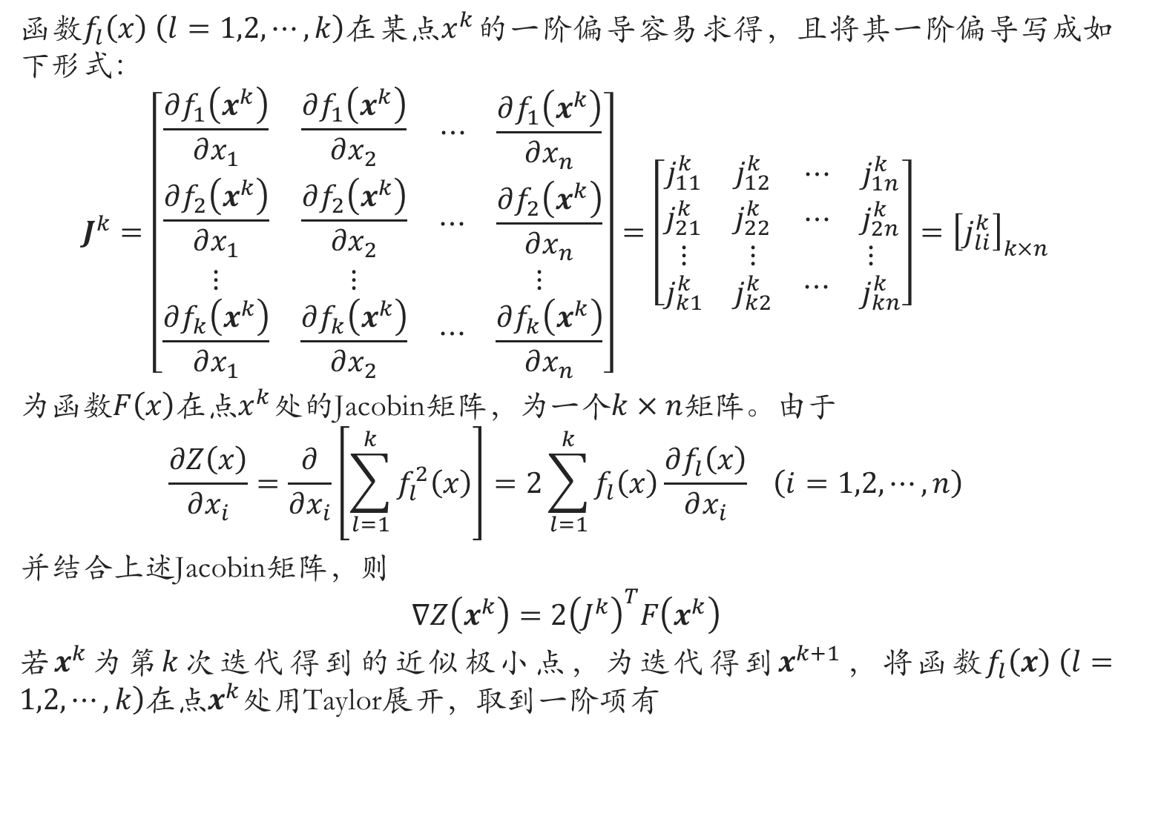
最小二乘(高斯牛顿法)
函数$f_{l}\left(x\right) \left(l=1,2,⋯,k\right)$在某点$x^{k}$的一阶偏导容易求得，且将其一阶偏导写成如下形式：
$$J^{k}=\left[\begin{matrix}\frac{∂f_{1}\left(x^{k}\right)}{∂x_{1}} & \frac{∂f_{1}\left(x^{k}\right)}{∂x_{2}} & \begin{matrix}⋯ & \frac{∂f_{1}\left(x^{k}\right)}{∂x_{n}}\end{matrix} \\ \frac{∂f_{2}\left(x^{k}\right)}{∂x_{1}} & \frac{∂f_{2}\left(x^{k}\right)}{∂x_{2}} & \begin{matrix}⋯ & \frac{∂f_{2}\left(x^{k}\right)}{∂x_{n}}\end{matrix} \\ \begin{matrix}⋮ \\ \frac{∂f_{k}\left(x^{k}\right)}{∂x_{1}}\end{matrix} & \begin{matrix}⋮ \\ \frac{∂f_{k}\left(x^{k}\right)}{∂x_{2}}\end{matrix} & \begin{matrix}\begin{matrix} \\ ⋯\end{matrix} & \begin{matrix}⋮ \\ \frac{∂f_{k}\left(x^{k}\right)}{∂x_{n}}\end{matrix}\end{matrix}\end{matrix}\right]=\left[\begin{matrix}j_{11}^{k} & j_{12}^{k} & \begin{matrix}⋯ & j_{1n}^{k}\end{matrix} \\ j_{21}^{k} & j_{22}^{k} & \begin{matrix}⋯ & j_{2n}^{k}\end{matrix} \\ \begin{matrix}⋮ \\ j_{k1}^{k}\end{matrix} & \begin{matrix}⋮ \\ j_{k2}^{k}\end{matrix} & \begin{matrix}\begin{matrix} \\ ⋯\end{matrix} & \begin{matrix}⋮ \\ j_{kn}^{k}\end{matrix}\end{matrix}\end{matrix}\right]={\left[j_{li}^{k}\right]}_{k×n}$$
为函数$F\left(x\right)$在点$x^{k}$处的Jacobin矩阵，为一个$k×n$矩阵。由于
$$\frac{∂Z\left(x\right)}{∂x_{i}}=\frac{∂}{∂x_{i}}\left[\sum_{l=1}^{k}{f_{l}^{2}\left(x\right)}\right]=2\sum_{l=1}^{k}{f_{l}\left(x\right)\frac{∂f_{l}\left(x\right)}{∂x_{i}}} \left(i=1,2,⋯,n\right)$$
并结合上述Jacobin矩阵，则
$$∇Z\left(x^{k}\right)=2{\left(J^{k}\right)}^{T}F\left(x^{k}\right)$$
若$x^{k}$为第$k$次迭代得到的近似极小点，为迭代得到$x^{k+1}$，将函数$f_{l}\left(x\right) \left(l=1,2,⋯,k\right)$在点$x^{k}$处用Taylor展开，取到一阶项有

Slide 13
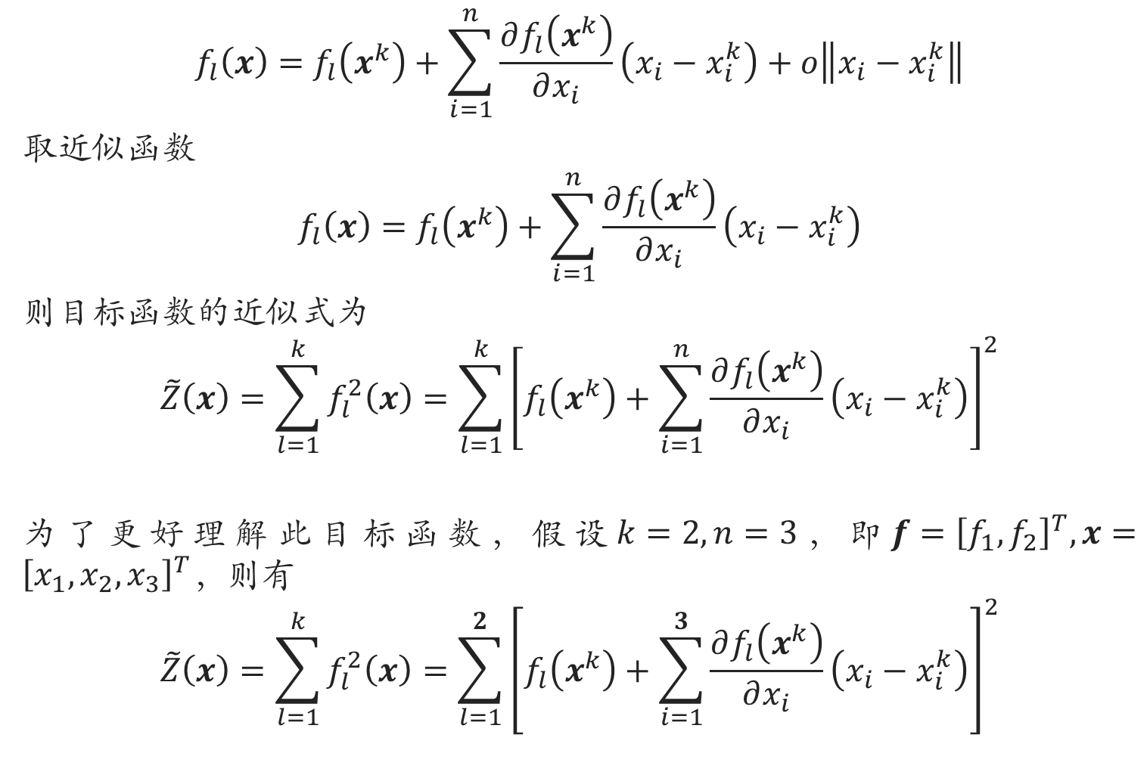
最小二乘(高斯牛顿法)
$$f_{l}\left(x\right)=f_{l}\left(x^{k}\right)+\sum_{i=1}^{n}{\frac{∂f_{l}\left(x^{k}\right)}{∂x_{i}}\left(x_{i}−x_{i}^{k}\right)}+o\left\|x_{i}−x_{i}^{k}\right\|$$
取近似函数
$$f_{l}\left(x\right)=f_{l}\left(x^{k}\right)+\sum_{i=1}^{n}{\frac{∂f_{l}\left(x^{k}\right)}{∂x_{i}}\left(x_{i}−x_{i}^{k}\right)}$$
则目标函数的近似式为
$$\tilde{Z}\left(x\right)=\sum_{l=1}^{k}{f_{l}^{2}\left(x\right)}=\sum_{l=1}^{k}{{\left[f_{l}\left(x^{k}\right)+\sum_{i=1}^{n}{\frac{∂f_{l}\left(x^{k}\right)}{∂x_{i}}\left(x_{i}−x_{i}^{k}\right)}\right]}^{2}}$$
为了更好理解此目标函数，假设$k=2,n=3$，即$f={\left[f_{1},f_{2}\right]}^{T},x={\left[x_{1},x_{2},x_{3}\right]}^{T}，$则有
$$\tilde{Z}\left(x\right)=\sum_{l=1}^{k}{f_{l}^{2}\left(x\right)}=\sum_{l=1}^{2}{{\left[f_{l}\left(x^{k}\right)+\sum_{i=1}^{3}{\frac{∂f_{l}\left(x^{k}\right)}{∂x_{i}}\left(x_{i}−x_{i}^{k}\right)}\right]}^{2}}$$

Slide 14
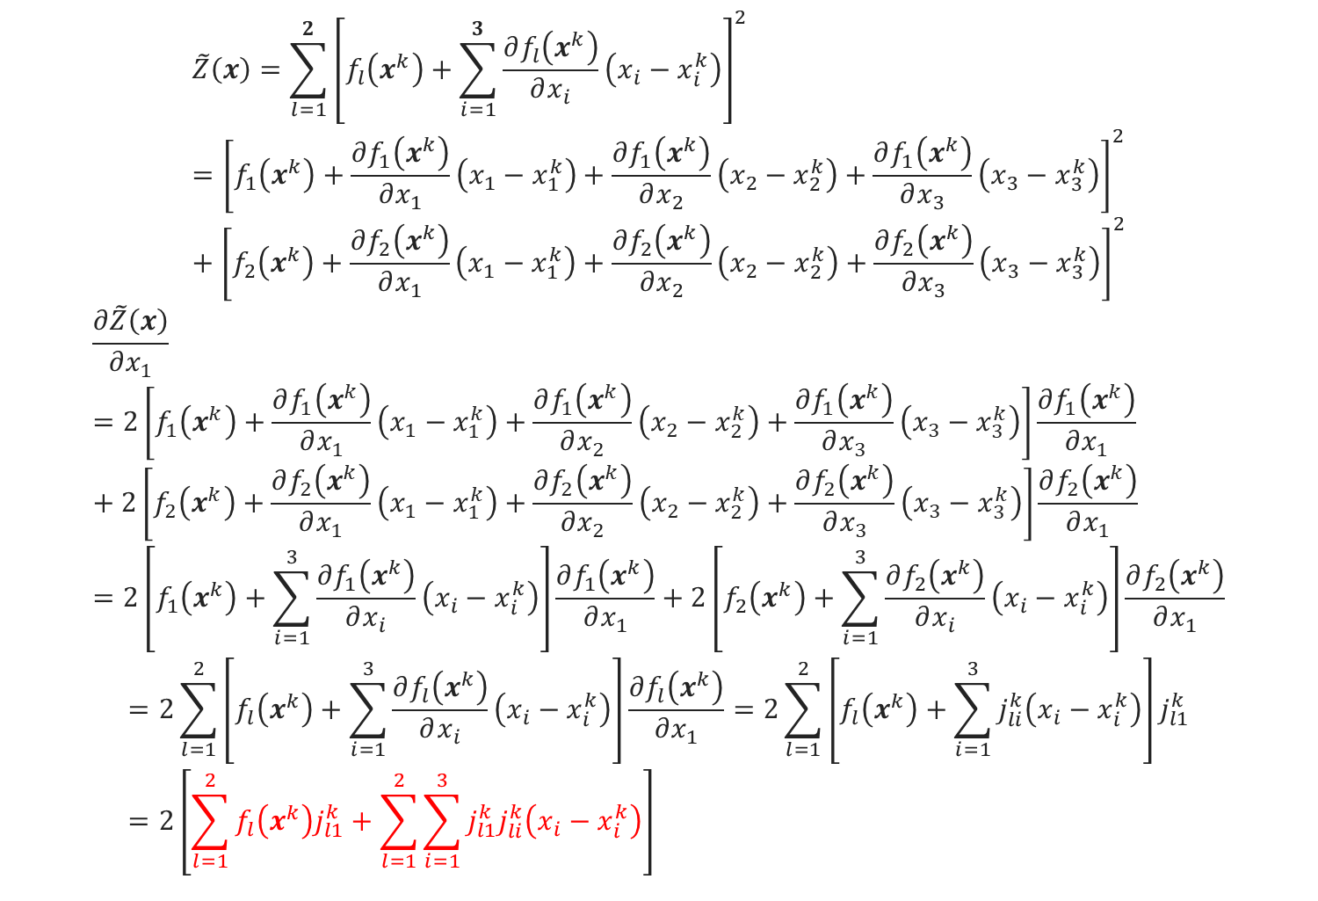
最小二乘(高斯牛顿法)
$$\tilde{Z}\left(x\right)=\sum_{l=1}^{2}{{\left[f_{l}\left(x^{k}\right)+\sum_{i=1}^{3}{\frac{∂f_{l}\left(x^{k}\right)}{∂x_{i}}\left(x_{i}−x_{i}^{k}\right)}\right]}^{2}}={\left[f_{1}\left(x^{k}\right)+\frac{∂f_{1}\left(x^{k}\right)}{∂x_{1}}\left(x_{1}−x_{1}^{k}\right)+\frac{∂f_{1}\left(x^{k}\right)}{∂x_{2}}\left(x_{2}−x_{2}^{k}\right)+\frac{∂f_{1}\left(x^{k}\right)}{∂x_{3}}\left(x_{3}−x_{3}^{k}\right)\right]}^{2}+{\left[f_{2}\left(x^{k}\right)+\frac{∂f_{2}\left(x^{k}\right)}{∂x_{1}}\left(x_{1}−x_{1}^{k}\right)+\frac{∂f_{2}\left(x^{k}\right)}{∂x_{2}}\left(x_{2}−x_{2}^{k}\right)+\frac{∂f_{2}\left(x^{k}\right)}{∂x_{3}}\left(x_{3}−x_{3}^{k}\right)\right]}^{2}$$
$$\frac{∂\tilde{Z}\left(x\right)}{∂x_{1}}=2\left[f_{1}\left(x^{k}\right)+\frac{∂f_{1}\left(x^{k}\right)}{∂x_{1}}\left(x_{1}−x_{1}^{k}\right)+\frac{∂f_{1}\left(x^{k}\right)}{∂x_{2}}\left(x_{2}−x_{2}^{k}\right)+\frac{∂f_{1}\left(x^{k}\right)}{∂x_{3}}\left(x_{3}−x_{3}^{k}\right)\right]\frac{∂f_{1}\left(x^{k}\right)}{∂x_{1}}+2\left[f_{2}\left(x^{k}\right)+\frac{∂f_{2}\left(x^{k}\right)}{∂x_{1}}\left(x_{1}−x_{1}^{k}\right)+\frac{∂f_{2}\left(x^{k}\right)}{∂x_{2}}\left(x_{2}−x_{2}^{k}\right)+\frac{∂f_{2}\left(x^{k}\right)}{∂x_{3}}\left(x_{3}−x_{3}^{k}\right)\right]\frac{∂f_{2}\left(x^{k}\right)}{∂x_{1}}=2\left[f_{1}\left(x^{k}\right)+\sum_{i=1}^{3}{\frac{∂f_{1}\left(x^{k}\right)}{∂x_{i}}\left(x_{i}−x_{i}^{k}\right)}\right]\frac{∂f_{1}\left(x^{k}\right)}{∂x_{1}}+2\left[f_{2}\left(x^{k}\right)+\sum_{i=1}^{3}{\frac{∂f_{2}\left(x^{k}\right)}{∂x_{i}}\left(x_{i}−x_{i}^{k}\right)}\right]\frac{∂f_{2}\left(x^{k}\right)}{∂x_{1}}$$
$$=2\sum_{l=1}^{2}{\left[f_{l}\left(x^{k}\right)+\sum_{i=1}^{3}{\frac{∂f_{l}\left(x^{k}\right)}{∂x_{i}}\left(x_{i}−x_{i}^{k}\right)}\right]\frac{∂f_{l}\left(x^{k}\right)}{∂x_{1}}}=2\sum_{l=1}^{2}{\left[f_{l}\left(x^{k}\right)+\sum_{i=1}^{3}{j_{li}^{k}\left(x_{i}−x_{i}^{k}\right)}\right]j_{l1}^{k}}=2\left[\sum_{l=1}^{2}{f_{l}\left(x^{k}\right)j_{l1}^{k}}+\sum_{l=1}^{2}{\sum_{i=1}^{3}{j_{l1}^{k}j_{li}^{k}\left(x_{i}−x_{i}^{k}\right)}}\right]$$

Slide 15
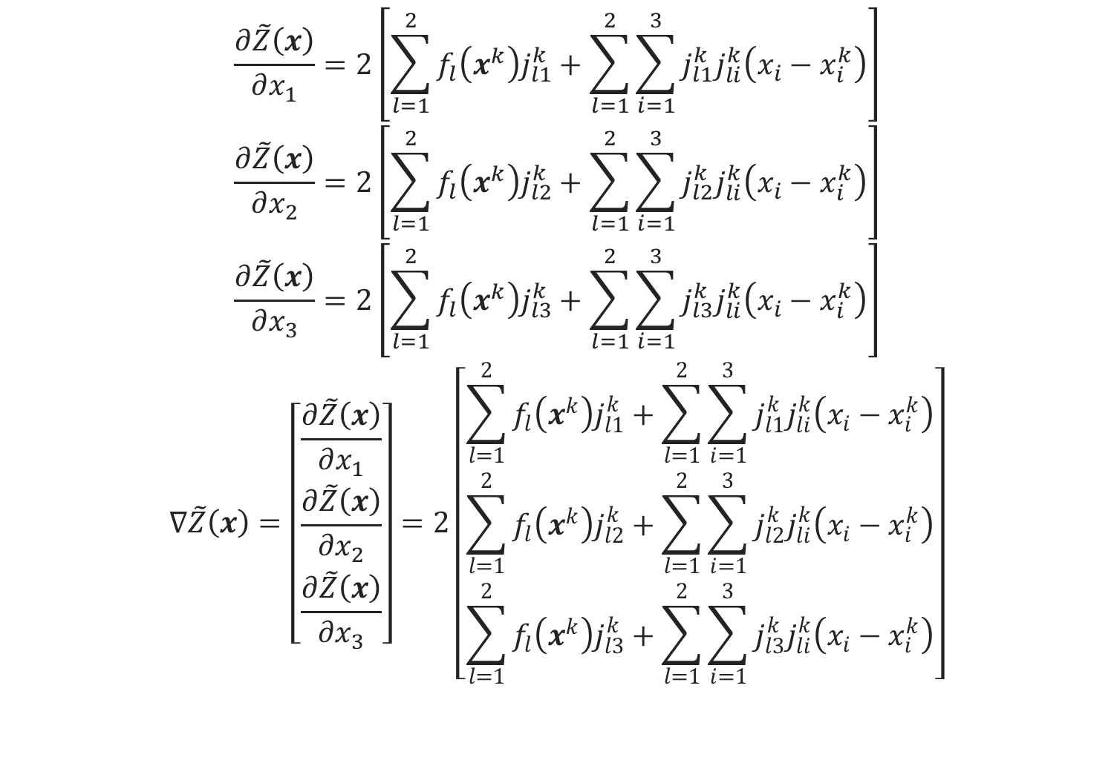
最小二乘(高斯牛顿法)
$$\frac{∂\tilde{Z}\left(x\right)}{∂x_{1}}=2\left[\sum_{l=1}^{2}{f_{l}\left(x^{k}\right)j_{l1}^{k}}+\sum_{l=1}^{2}{\sum_{i=1}^{3}{j_{l1}^{k}j_{li}^{k}\left(x_{i}−x_{i}^{k}\right)}}\right]$$
$$\frac{∂\tilde{Z}\left(x\right)}{∂x_{2}}=2\left[\sum_{l=1}^{2}{f_{l}\left(x^{k}\right)j_{l2}^{k}}+\sum_{l=1}^{2}{\sum_{i=1}^{3}{j_{l2}^{k}j_{li}^{k}\left(x_{i}−x_{i}^{k}\right)}}\right]$$
$$\frac{∂\tilde{Z}\left(x\right)}{∂x_{3}}=2\left[\sum_{l=1}^{2}{f_{l}\left(x^{k}\right)j_{l3}^{k}}+\sum_{l=1}^{2}{\sum_{i=1}^{3}{j_{l3}^{k}j_{li}^{k}\left(x_{i}−x_{i}^{k}\right)}}\right]$$
$$∇\tilde{Z}\left(x\right)=\left[\begin{matrix}\frac{∂\tilde{Z}\left(x\right)}{∂x_{1}} \\ \frac{∂\tilde{Z}\left(x\right)}{∂x_{2}} \\ \frac{∂\tilde{Z}\left(x\right)}{∂x_{3}}\end{matrix}\right]=2\left[\begin{matrix}\sum_{l=1}^{2}{f_{l}\left(x^{k}\right)j_{l1}^{k}}+\sum_{l=1}^{2}{\sum_{i=1}^{3}{j_{l1}^{k}j_{li}^{k}\left(x_{i}−x_{i}^{k}\right)}} \\ \sum_{l=1}^{2}{f_{l}\left(x^{k}\right)j_{l2}^{k}}+\sum_{l=1}^{2}{\sum_{i=1}^{3}{j_{l2}^{k}j_{li}^{k}\left(x_{i}−x_{i}^{k}\right)}} \\ \sum_{l=1}^{2}{f_{l}\left(x^{k}\right)j_{l3}^{k}}+\sum_{l=1}^{2}{\sum_{i=1}^{3}{j_{l3}^{k}j_{li}^{k}\left(x_{i}−x_{i}^{k}\right)}}\end{matrix}\right]$$

Slide 16
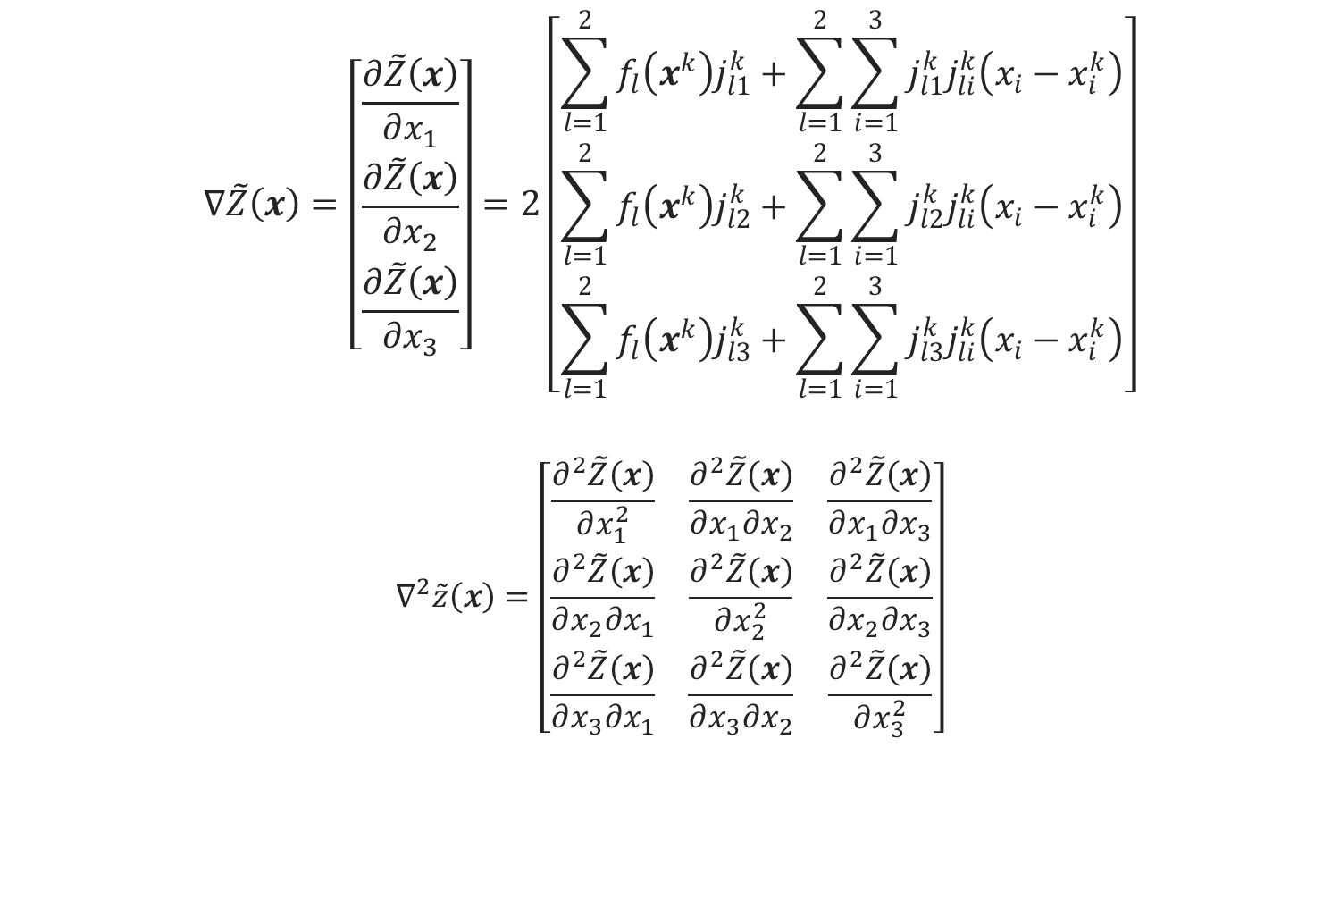
最小二乘(高斯牛顿法)
$$∇\tilde{Z}\left(x\right)=\left[\begin{matrix}\frac{∂\tilde{Z}\left(x\right)}{∂x_{1}} \\ \frac{∂\tilde{Z}\left(x\right)}{∂x_{2}} \\ \frac{∂\tilde{Z}\left(x\right)}{∂x_{3}}\end{matrix}\right]=2\left[\begin{matrix}\sum_{l=1}^{2}{f_{l}\left(x^{k}\right)j_{l1}^{k}}+\sum_{l=1}^{2}{\sum_{i=1}^{3}{j_{l1}^{k}j_{li}^{k}\left(x_{i}−x_{i}^{k}\right)}} \\ \sum_{l=1}^{2}{f_{l}\left(x^{k}\right)j_{l2}^{k}}+\sum_{l=1}^{2}{\sum_{i=1}^{3}{j_{l2}^{k}j_{li}^{k}\left(x_{i}−x_{i}^{k}\right)}} \\ \sum_{l=1}^{2}{f_{l}\left(x^{k}\right)j_{l3}^{k}}+\sum_{l=1}^{2}{\sum_{i=1}^{3}{j_{l3}^{k}j_{li}^{k}\left(x_{i}−x_{i}^{k}\right)}}\end{matrix}\right]$$
$$∇^{2}\tilde{z}\left(x\right)=\left[\begin{matrix}\frac{∂^{2}\tilde{Z}\left(x\right)}{∂x_{1}^{2}} & \frac{∂^{2}\tilde{Z}\left(x\right)}{∂x_{1}∂x_{2}} & \frac{∂^{2}\tilde{Z}\left(x\right)}{∂x_{1}∂x_{3}} \\ \frac{∂^{2}\tilde{Z}\left(x\right)}{∂x_{2}∂x_{1}} & \frac{∂^{2}\tilde{Z}\left(x\right)}{∂x_{2}^{2}} & \frac{∂^{2}\tilde{Z}\left(x\right)}{∂x_{2}∂x_{3}} \\ \frac{∂^{2}\tilde{Z}\left(x\right)}{∂x_{3}∂x_{1}} & \frac{∂^{2}\tilde{Z}\left(x\right)}{∂x_{3}∂x_{2}} & \frac{∂^{2}\tilde{Z}\left(x\right)}{∂x_{3}^{2}}\end{matrix}\right]$$

Slide 17
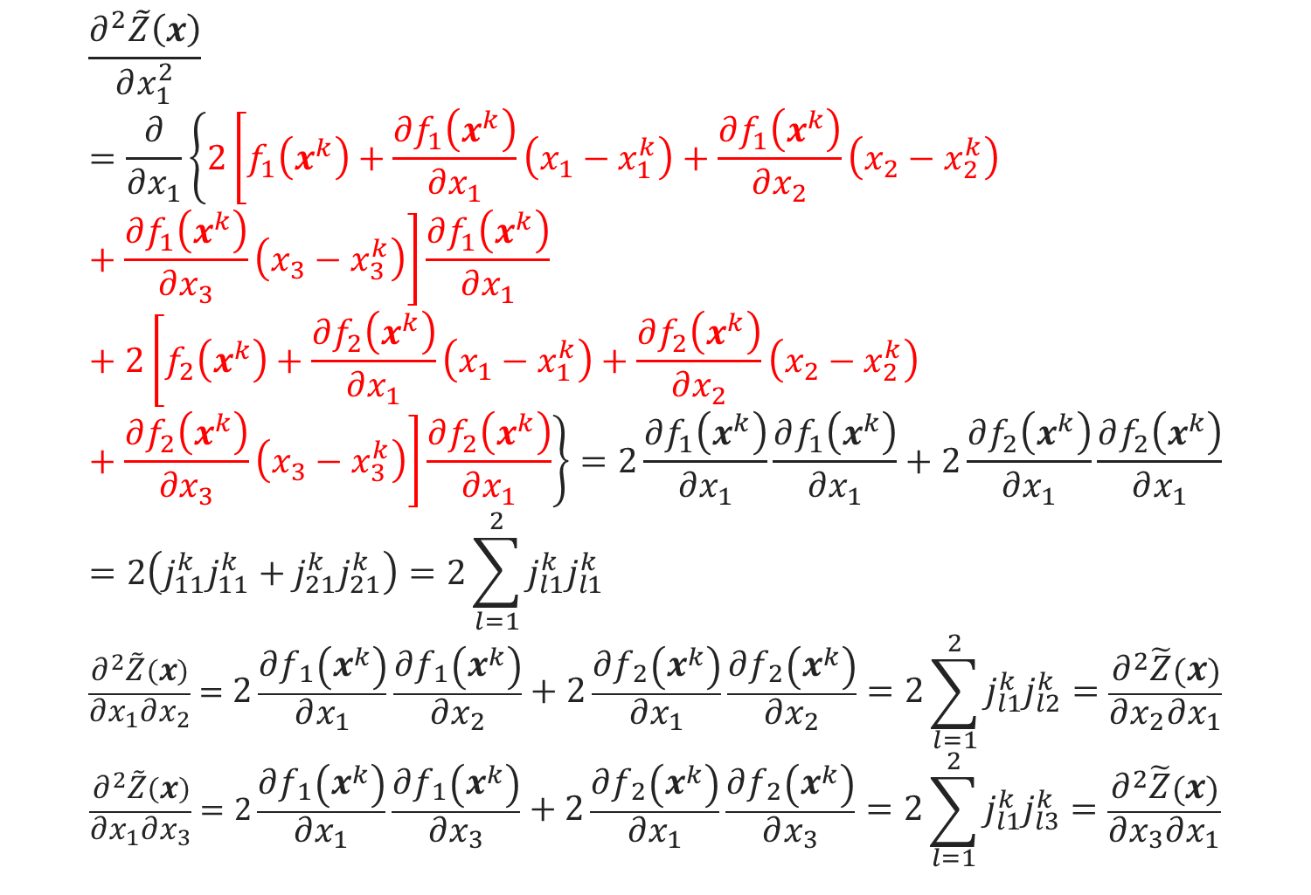
最小二乘(高斯牛顿法)
$$\frac{∂^{2}\tilde{Z}\left(x\right)}{∂x_{1}^{2}}=\frac{∂}{∂x_{1}}\left\{2\left[f_{1}\left(x^{k}\right)+\frac{∂f_{1}\left(x^{k}\right)}{∂x_{1}}\left(x_{1}−x_{1}^{k}\right)+\frac{∂f_{1}\left(x^{k}\right)}{∂x_{2}}\left(x_{2}−x_{2}^{k}\right)+\frac{∂f_{1}\left(x^{k}\right)}{∂x_{3}}\left(x_{3}−x_{3}^{k}\right)\right]\frac{∂f_{1}\left(x^{k}\right)}{∂x_{1}}+2\left[f_{2}\left(x^{k}\right)+\frac{∂f_{2}\left(x^{k}\right)}{∂x_{1}}\left(x_{1}−x_{1}^{k}\right)+\frac{∂f_{2}\left(x^{k}\right)}{∂x_{2}}\left(x_{2}−x_{2}^{k}\right)+\frac{∂f_{2}\left(x^{k}\right)}{∂x_{3}}\left(x_{3}−x_{3}^{k}\right)\right]\frac{∂f_{2}\left(x^{k}\right)}{∂x_{1}}\right\}=2\frac{∂f_{1}\left(x^{k}\right)}{∂x_{1}}\frac{∂f_{1}\left(x^{k}\right)}{∂x_{1}}+2\frac{∂f_{2}\left(x^{k}\right)}{∂x_{1}}\frac{∂f_{2}\left(x^{k}\right)}{∂x_{1}}=2\left(j_{11}^{k}j_{11}^{k}+j_{21}^{k}j_{21}^{k}\right)=2\sum_{l=1}^{2}{j_{l1}^{k}j_{l1}^{k}}$$
$$\frac{∂^{2}\tilde{Z}\left(x\right)}{∂x_{1}∂x_{2}}=2\frac{∂f_{1}\left(x^{k}\right)}{∂x_{1}}\frac{∂f_{1}\left(x^{k}\right)}{∂x_{2}}+2\frac{∂f_{2}\left(x^{k}\right)}{∂x_{1}}\frac{∂f_{2}\left(x^{k}\right)}{∂x_{2}}=2\sum_{l=1}^{2}{j_{l1}^{k}j_{l2}^{k}}=\frac{∂^{2}\tilde{Z}\left(x\right)}{∂x_{2}∂x_{1}}$$
$$\frac{∂^{2}\tilde{Z}\left(x\right)}{∂x_{1}∂x_{3}}=2\frac{∂f_{1}\left(x^{k}\right)}{∂x_{1}}\frac{∂f_{1}\left(x^{k}\right)}{∂x_{3}}+2\frac{∂f_{2}\left(x^{k}\right)}{∂x_{1}}\frac{∂f_{2}\left(x^{k}\right)}{∂x_{3}}=2\sum_{l=1}^{2}{j_{l1}^{k}j_{l3}^{k}}=\frac{∂^{2}\tilde{Z}\left(x\right)}{∂x_{3}∂x_{1}}$$

Slide 18
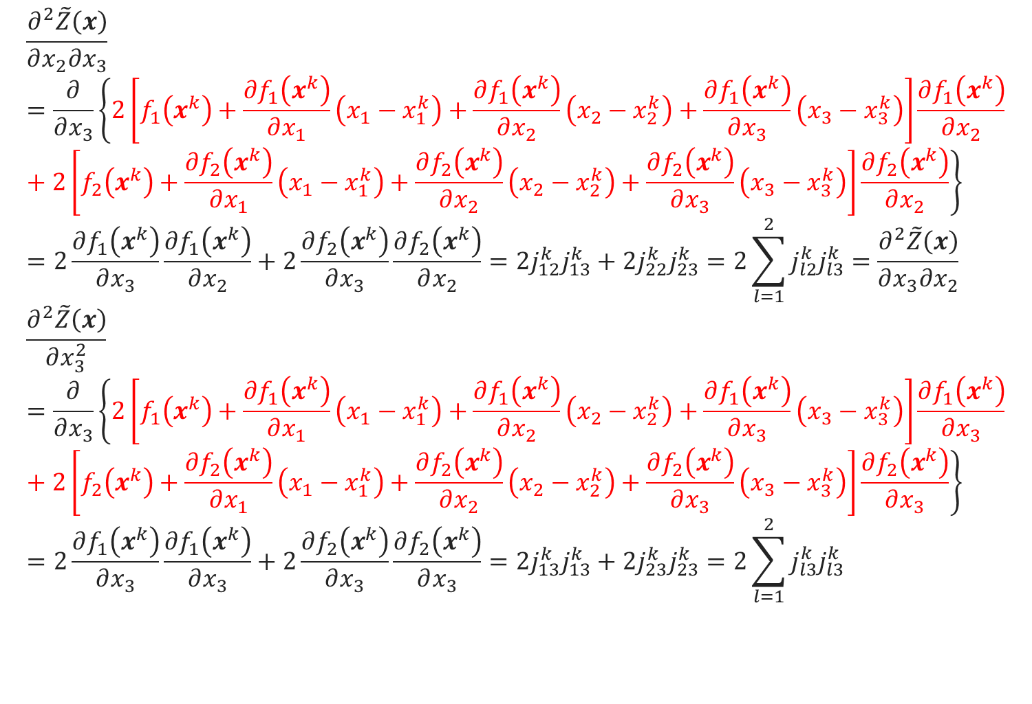
最小二乘(高斯牛顿法)
$$\frac{∂^{2}\tilde{Z}\left(x\right)}{∂x_{2}∂x_{3}}=\frac{∂}{∂x_{3}}\left\{2\left[f_{1}\left(x^{k}\right)+\frac{∂f_{1}\left(x^{k}\right)}{∂x_{1}}\left(x_{1}−x_{1}^{k}\right)+\frac{∂f_{1}\left(x^{k}\right)}{∂x_{2}}\left(x_{2}−x_{2}^{k}\right)+\frac{∂f_{1}\left(x^{k}\right)}{∂x_{3}}\left(x_{3}−x_{3}^{k}\right)\right]\frac{∂f_{1}\left(x^{k}\right)}{∂x_{2}}+2\left[f_{2}\left(x^{k}\right)+\frac{∂f_{2}\left(x^{k}\right)}{∂x_{1}}\left(x_{1}−x_{1}^{k}\right)+\frac{∂f_{2}\left(x^{k}\right)}{∂x_{2}}\left(x_{2}−x_{2}^{k}\right)+\frac{∂f_{2}\left(x^{k}\right)}{∂x_{3}}\left(x_{3}−x_{3}^{k}\right)\right]\frac{∂f_{2}\left(x^{k}\right)}{∂x_{2}}\right\}=2\frac{∂f_{1}\left(x^{k}\right)}{∂x_{3}}\frac{∂f_{1}\left(x^{k}\right)}{∂x_{2}}+2\frac{∂f_{2}\left(x^{k}\right)}{∂x_{3}}\frac{∂f_{2}\left(x^{k}\right)}{∂x_{2}}=2j_{12}^{k}j_{13}^{k}+2j_{22}^{k}j_{23}^{k}=2\sum_{l=1}^{2}{j_{l2}^{k}j_{l3}^{k}}=\frac{∂^{2}\tilde{Z}\left(x\right)}{∂x_{3}∂x_{2}}$$
$$\frac{∂^{2}\tilde{Z}\left(x\right)}{∂x_{3}^{2}}=\frac{∂}{∂x_{3}}\left\{2\left[f_{1}\left(x^{k}\right)+\frac{∂f_{1}\left(x^{k}\right)}{∂x_{1}}\left(x_{1}−x_{1}^{k}\right)+\frac{∂f_{1}\left(x^{k}\right)}{∂x_{2}}\left(x_{2}−x_{2}^{k}\right)+\frac{∂f_{1}\left(x^{k}\right)}{∂x_{3}}\left(x_{3}−x_{3}^{k}\right)\right]\frac{∂f_{1}\left(x^{k}\right)}{∂x_{3}}+2\left[f_{2}\left(x^{k}\right)+\frac{∂f_{2}\left(x^{k}\right)}{∂x_{1}}\left(x_{1}−x_{1}^{k}\right)+\frac{∂f_{2}\left(x^{k}\right)}{∂x_{2}}\left(x_{2}−x_{2}^{k}\right)+\frac{∂f_{2}\left(x^{k}\right)}{∂x_{3}}\left(x_{3}−x_{3}^{k}\right)\right]\frac{∂f_{2}\left(x^{k}\right)}{∂x_{3}}\right\}=2\frac{∂f_{1}\left(x^{k}\right)}{∂x_{3}}\frac{∂f_{1}\left(x^{k}\right)}{∂x_{3}}+2\frac{∂f_{2}\left(x^{k}\right)}{∂x_{3}}\frac{∂f_{2}\left(x^{k}\right)}{∂x_{3}}=2j_{13}^{k}j_{13}^{k}+2j_{23}^{k}j_{23}^{k}=2\sum_{l=1}^{2}{j_{l3}^{k}j_{l3}^{k}}$$

Slide 19
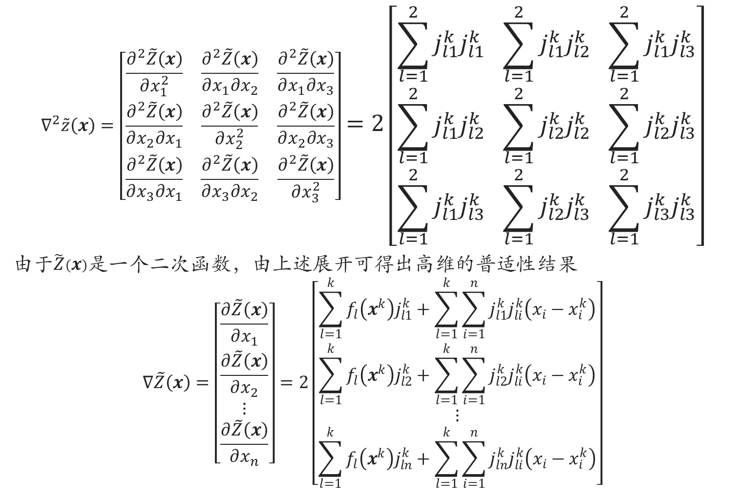
最小二乘(高斯牛顿法)
$$∇^{2}\tilde{z}\left(x\right)=\left[\begin{matrix}\frac{∂^{2}\tilde{Z}\left(x\right)}{∂x_{1}^{2}} & \frac{∂^{2}\tilde{Z}\left(x\right)}{∂x_{1}∂x_{2}} & \frac{∂^{2}\tilde{Z}\left(x\right)}{∂x_{1}∂x_{3}} \\ \frac{∂^{2}\tilde{Z}\left(x\right)}{∂x_{2}∂x_{1}} & \frac{∂^{2}\tilde{Z}\left(x\right)}{∂x_{2}^{2}} & \frac{∂^{2}\tilde{Z}\left(x\right)}{∂x_{2}∂x_{3}} \\ \frac{∂^{2}\tilde{Z}\left(x\right)}{∂x_{3}∂x_{1}} & \frac{∂^{2}\tilde{Z}\left(x\right)}{∂x_{3}∂x_{2}} & \frac{∂^{2}\tilde{Z}\left(x\right)}{∂x_{3}^{2}}\end{matrix}\right]=2\left[\begin{matrix}\sum_{l=1}^{2}{j_{l1}^{k}j_{l1}^{k}} & \sum_{l=1}^{2}{j_{l1}^{k}j_{l2}^{k}} & \sum_{l=1}^{2}{j_{l1}^{k}j_{l3}^{k}} \\ \sum_{l=1}^{2}{j_{l1}^{k}j_{l2}^{k}} & \sum_{l=1}^{2}{j_{l2}^{k}j_{l2}^{k}} & \sum_{l=1}^{2}{j_{l2}^{k}j_{l3}^{k}} \\ \sum_{l=1}^{2}{j_{l1}^{k}j_{l3}^{k}} & \sum_{l=1}^{2}{j_{l2}^{k}j_{l3}^{k}} & \sum_{l=1}^{2}{j_{l3}^{k}j_{l3}^{k}}\end{matrix}\right]$$
由于$\tilde{Z}\left(x\right)$是一个二次函数，由上述展开可得出高维的普适性结果
$$∇\tilde{Z}\left(x\right)=\left[\begin{matrix}\frac{∂\tilde{Z}\left(x\right)}{∂x_{1}} \\ \begin{matrix}\frac{∂\tilde{Z}\left(x\right)}{∂x_{2}} \\ \begin{matrix}⋮ \\ \frac{∂\tilde{Z}\left(x\right)}{∂x_{n}}\end{matrix}\end{matrix}\end{matrix}\right]=2\left[\begin{matrix}\sum_{l=1}^{k}{f_{l}\left(x^{k}\right)j_{l1}^{k}}+\sum_{l=1}^{k}{\sum_{i=1}^{n}{j_{l1}^{k}j_{li}^{k}\left(x_{i}−x_{i}^{k}\right)}} \\ \begin{matrix}\sum_{l=1}^{k}{f_{l}\left(x^{k}\right)j_{l2}^{k}}+\sum_{l=1}^{k}{\sum_{i=1}^{n}{j_{l2}^{k}j_{li}^{k}\left(x_{i}−x_{i}^{k}\right)}} \\ \begin{matrix}⋮ \\ \sum_{l=1}^{k}{f_{l}\left(x^{k}\right)j_{ln}^{k}}+\sum_{l=1}^{k}{\sum_{i=1}^{n}{j_{ln}^{k}j_{li}^{k}\left(x_{i}−x_{i}^{k}\right)}}\end{matrix}\end{matrix}\end{matrix}\right]$$

Slide 20
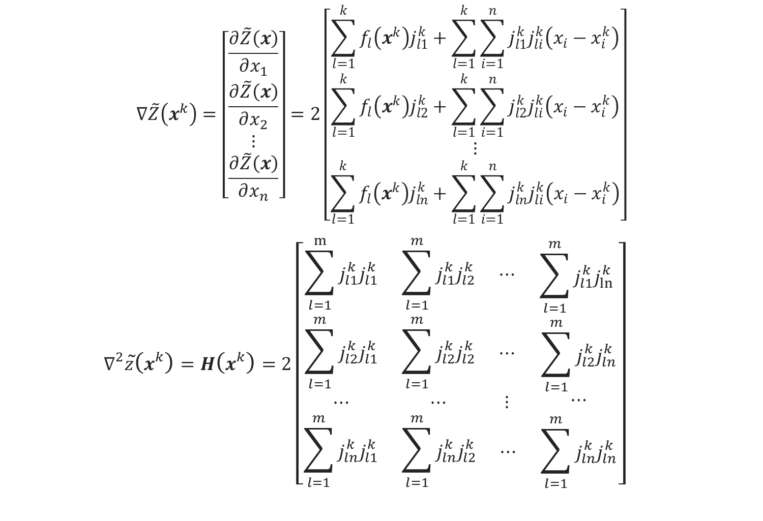
最小二乘(高斯牛顿法)
$$∇\tilde{Z}\left(x^{k}\right)=\left[\begin{matrix}\frac{∂\tilde{Z}\left(x\right)}{∂x_{1}} \\ \begin{matrix}\frac{∂\tilde{Z}\left(x\right)}{∂x_{2}} \\ \begin{matrix}⋮ \\ \frac{∂\tilde{Z}\left(x\right)}{∂x_{n}}\end{matrix}\end{matrix}\end{matrix}\right]=2\left[\begin{matrix}\sum_{l=1}^{k}{f_{l}\left(x^{k}\right)j_{l1}^{k}}+\sum_{l=1}^{k}{\sum_{i=1}^{n}{j_{l1}^{k}j_{li}^{k}\left(x_{i}−x_{i}^{k}\right)}} \\ \begin{matrix}\sum_{l=1}^{k}{f_{l}\left(x^{k}\right)j_{l2}^{k}}+\sum_{l=1}^{k}{\sum_{i=1}^{n}{j_{l2}^{k}j_{li}^{k}\left(x_{i}−x_{i}^{k}\right)}} \\ \begin{matrix}⋮ \\ \sum_{l=1}^{k}{f_{l}\left(x^{k}\right)j_{ln}^{k}}+\sum_{l=1}^{k}{\sum_{i=1}^{n}{j_{ln}^{k}j_{li}^{k}\left(x_{i}−x_{i}^{k}\right)}}\end{matrix}\end{matrix}\end{matrix}\right]$$
$$∇^{2}\tilde{z}\left(x^{k}\right)=H\left(x^{k}\right)=2\left[\begin{matrix}\begin{matrix}\sum_{l=1}^{m}{j_{l1}^{k}j_{l1}^{k}} & \sum_{l=1}^{m}{j_{l1}^{k}j_{l2}^{k}} & ⋯ \\ \sum_{l=1}^{m}{j_{l2}^{k}j_{l1}^{k}} & \sum_{l=1}^{m}{j_{l2}^{k}j_{l2}^{k}} & ⋯ \\ ⋯ & ⋯ & ⋮\end{matrix} & \begin{matrix}\sum_{l=1}^{m}{j_{l1}^{k}j_{ln}^{k} } \\ \sum_{l=1}^{m}{j_{l2}^{k}j_{ln}^{k}} \\ ⋯\end{matrix} \\ \begin{matrix}\sum_{l=1}^{m}{j_{ln}^{k}j_{l1}^{k}} & \sum_{l=1}^{m}{j_{ln}^{k}j_{l2}^{k}} & ⋯\end{matrix} & \sum_{l=1}^{m}{j_{ln}^{k}j_{ln}^{k}}\end{matrix}\right]$$

Slide 21
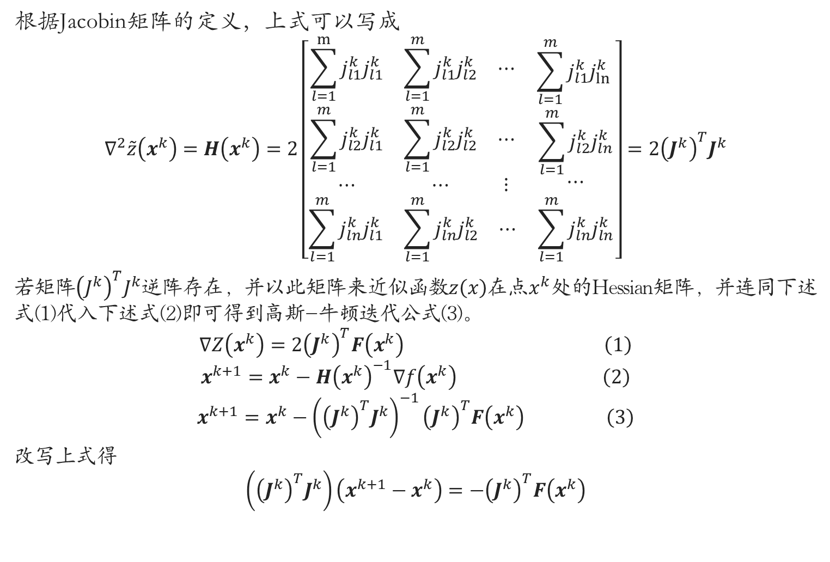
最小二乘(高斯牛顿法)
根据Jacobin矩阵的定义，上式可以写成
$$∇^{2}\tilde{z}\left(x^{k}\right)=H\left(x^{k}\right)=2\left[\begin{matrix}\begin{matrix}\sum_{l=1}^{m}{j_{l1}^{k}j_{l1}^{k}} & \sum_{l=1}^{m}{j_{l1}^{k}j_{l2}^{k}} & ⋯ \\ \sum_{l=1}^{m}{j_{l2}^{k}j_{l1}^{k}} & \sum_{l=1}^{m}{j_{l2}^{k}j_{l2}^{k}} & ⋯ \\ ⋯ & ⋯ & ⋮\end{matrix} & \begin{matrix}\sum_{l=1}^{m}{j_{l1}^{k}j_{ln}^{k} } \\ \sum_{l=1}^{m}{j_{l2}^{k}j_{ln}^{k}} \\ ⋯\end{matrix} \\ \begin{matrix}\sum_{l=1}^{m}{j_{ln}^{k}j_{l1}^{k}} & \sum_{l=1}^{m}{j_{ln}^{k}j_{l2}^{k}} & ⋯\end{matrix} & \sum_{l=1}^{m}{j_{ln}^{k}j_{ln}^{k}}\end{matrix}\right]=2{\left(J^{k}\right)}^{T}J^{k}$$
若矩阵${\left(J^{k}\right)}^{T}J^{k}$逆阵存在，并以此矩阵来近似函数$z\left(x\right)$在点$x^{k}$处的Hessian矩阵，并连同下述式(1)代入下述式(2)即可得到高斯-牛顿迭代公式(3)。
$$\begin{aligned}∇Z\left(x^{k}\right)=2{\left(J^{k}\right)}^{T}F\left(x^{k}\right) \#\left(1\right)\end{aligned}$$
$$\begin{aligned}x^{k+1}=x^{k}−H{\left(x^{k}\right)}^{−1}∇f\left(x^{k}\right) \#\left(2\right)\end{aligned}$$
$$\begin{aligned}x^{k+1}=x^{k}−{\left({\left(J^{k}\right)}^{T}J^{k}\right)}^{−1}{\left(J^{k}\right)}^{T}F\left(x^{k}\right) \#\left(3\right)\end{aligned}$$
改写上式得
$$\left({\left(J^{k}\right)}^{T}J^{k}\right)\left(x^{k+1}−x^{k}\right)=−{\left(J^{k}\right)}^{T}F\left(x^{k}\right)$$

Slide 22
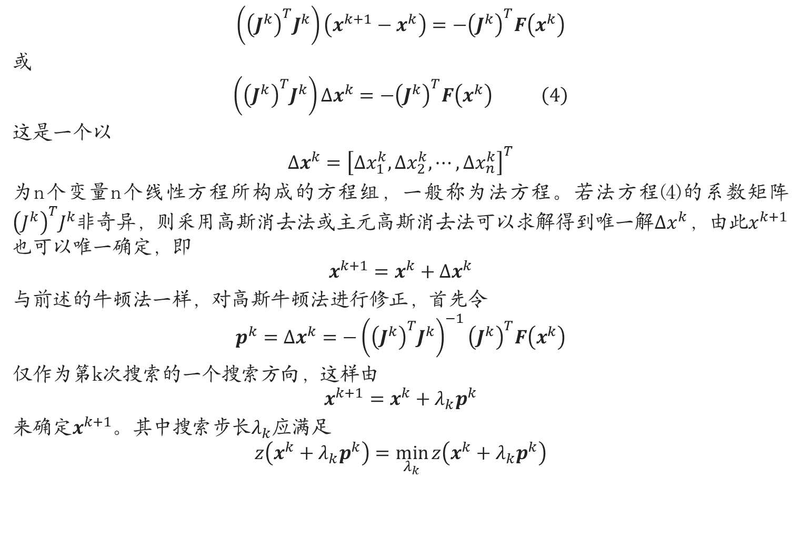
最小二乘(高斯牛顿法)
$$\left({\left(J^{k}\right)}^{T}J^{k}\right)\left(x^{k+1}−x^{k}\right)=−{\left(J^{k}\right)}^{T}F\left(x^{k}\right)$$
或
$$\begin{aligned}\left({\left(J^{k}\right)}^{T}J^{k}\right)Δx^{k}=−{\left(J^{k}\right)}^{T}F\left(x^{k}\right) \#\left(4\right)\end{aligned}$$
这是一个以
$$Δx^{k}={\left[Δx_{1}^{k},Δx_{2}^{k},⋯,Δx_{n}^{k}\right]}^{T}$$
为n个变量n个线性方程所构成的方程组，一般称为法方程。若法方程(4)的系数矩阵${\left(J^{k}\right)}^{T}J^{k}$非奇异，则采用高斯消去法或主元高斯消去法可以求解得到唯一解$Δx^{k}$，由此$x^{k+1}$也可以唯一确定，即
$$x^{k+1}=x^{k}+Δx^{k}$$
与前述的牛顿法一样，对高斯牛顿法进行修正，首先令
$$p^{k}=Δx^{k}=−{\left({\left(J^{k}\right)}^{T}J^{k}\right)}^{−1}{\left(J^{k}\right)}^{T}F\left(x^{k}\right)$$
仅作为第k次搜索的一个搜索方向，这样由
$$x^{k+1}=x^{k}+λ_{k}p^{k}$$
来确定$x^{k+1}$。其中搜索步长$λ_{k}$应满足
$$z\left(x^{k}+λ_{k}p^{k}\right)=\min_{λ_{k}}{z\left(x^{k}+λ_{k}p^{k}\right)}$$

Slide 23
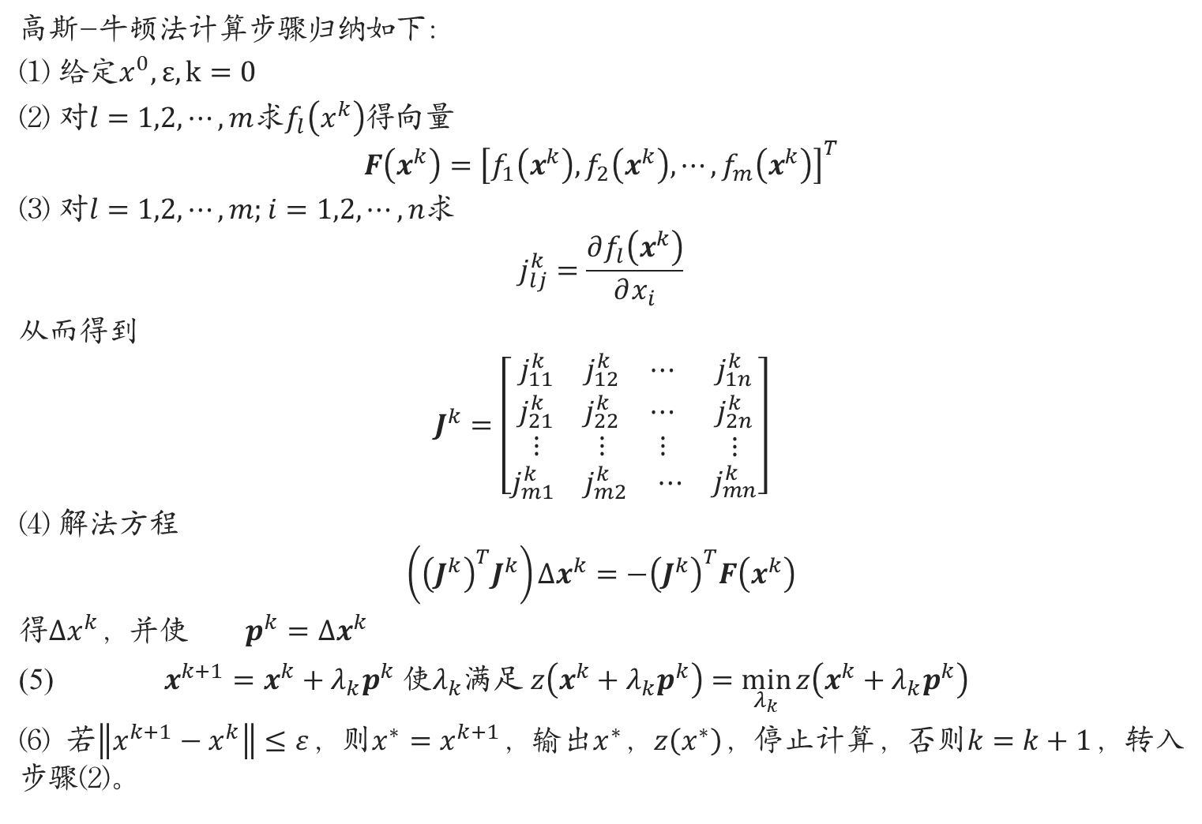
最小二乘(高斯牛顿法)
高斯-牛顿法计算步骤归纳如下：
(1) 给定$x^{0},ε,k=0$
(2) 对$l=1,2,⋯,m$求$f_{l}\left(x^{k}\right)$得向量
$$F\left(x^{k}\right)={\left[f_{1}\left(x^{k}\right),f_{2}\left(x^{k}\right),⋯,f_{m}\left(x^{k}\right)\right]}^{T}$$
(3) 对$l=1,2,⋯,m;i=1,2,⋯,n$求
$$j_{lj}^{k}=\frac{∂f_{l}\left(x^{k}\right)}{∂x_{i}}$$
从而得到
$$J^{k}=\left[\begin{matrix}\begin{matrix}j_{11}^{k} & j_{12}^{k} & ⋯ \\ j_{21}^{k} & j_{22}^{k} & ⋯ \\ ⋮ & ⋮ & ⋮\end{matrix} & \begin{matrix}j_{1n}^{k} \\ j_{2n}^{k} \\ ⋮\end{matrix} \\ \begin{matrix}j_{m1}^{k} & j_{m2}^{k} & ⋯\end{matrix} & j_{mn}^{k}\end{matrix}\right]$$
(4) 解法方程
$$\left({\left(J^{k}\right)}^{T}J^{k}\right)Δx^{k}=−{\left(J^{k}\right)}^{T}F\left(x^{k}\right)$$
得$Δx^{k}$，并使 $p^{k}=Δx^{k}$
(5) $x^{k+1}=x^{k}+λ_{k}p^{k}$ 使$λ_{k}$满足 $z\left(x^{k}+λ_{k}p^{k}\right)=\min_{λ_{k}}{z\left(x^{k}+λ_{k}p^{k}\right)}$
(6) 若$\left\|x^{k+1}−x^{k}\right\|≤ε$，则$x^{∗}=x^{k+1}$，输出$x^{∗}$，$z\left(x^{∗}\right)$，停止计算，否则$k=k+1$，转入步骤(2)。

Slide 24
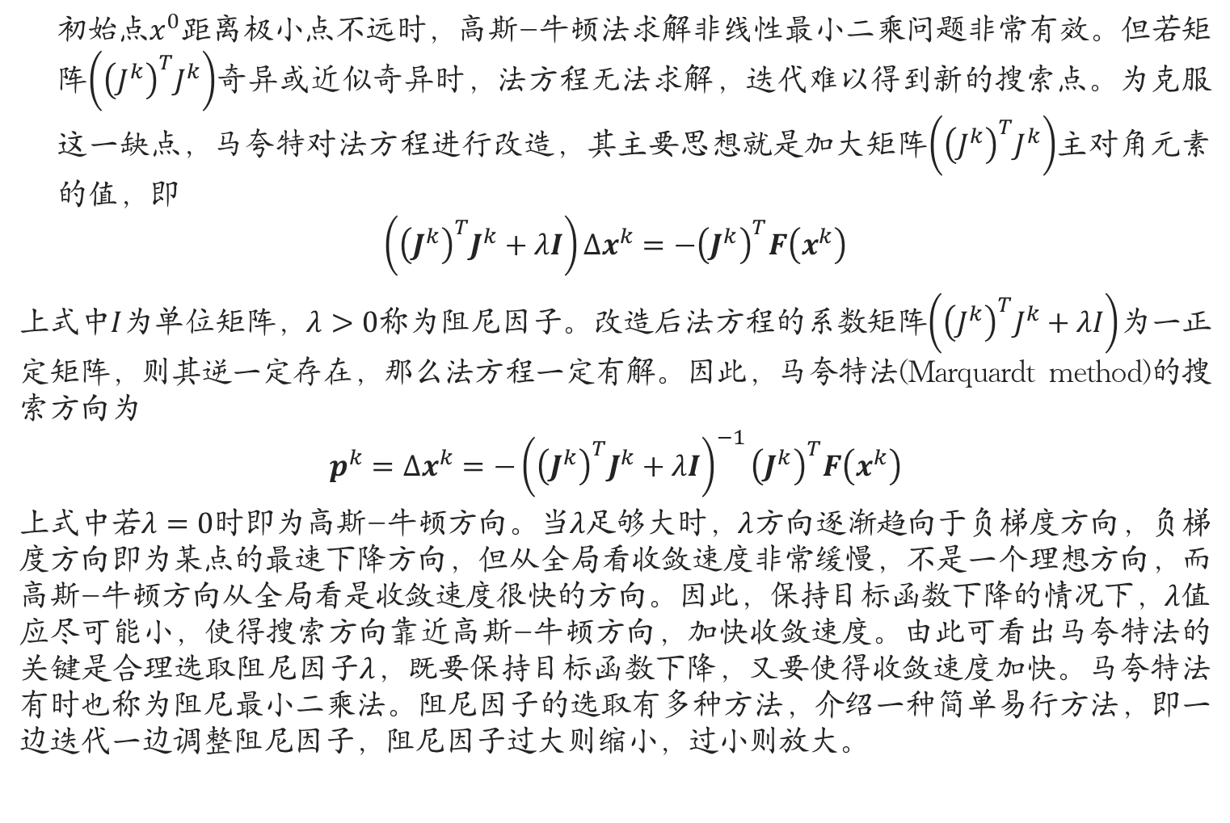
马夸特法(Marquardt method)
初始点$x^{0}$距离极小点不远时，高斯-牛顿法求解非线性最小二乘问题非常有效。但若矩阵$\left({\left(J^{k}\right)}^{T}J^{k}\right)$奇异或近似奇异时，法方程无法求解，迭代难以得到新的搜索点。为克服这一缺点，马夸特对法方程进行改造，其主要思想就是加大矩阵$\left({\left(J^{k}\right)}^{T}J^{k}\right)$主对角元素的值，即
$$\left({\left(J^{k}\right)}^{T}J^{k}+λI\right)Δx^{k}=−{\left(J^{k}\right)}^{T}F\left(x^{k}\right)$$
上式中$I$为单位矩阵，$λ>0$称为阻尼因子。改造后法方程的系数矩阵$\left({\left(J^{k}\right)}^{T}J^{k}+λI\right)$为一正定矩阵，则其逆一定存在，那么法方程一定有解。因此，马夸特法(Marquardt method)的搜索方向为
$$p^{k}=Δx^{k}=−{\left({\left(J^{k}\right)}^{T}J^{k}+λI\right)}^{−1}{\left(J^{k}\right)}^{T}F\left(x^{k}\right)$$
上式中若$λ=0$时即为高斯-牛顿方向。当$λ$足够大时，$λ$方向逐渐趋向于负梯度方向，负梯度方向即为某点的最速下降方向，但从全局看收敛速度非常缓慢，不是一个理想方向，而高斯-牛顿方向从全局看是收敛速度很快的方向。因此，保持目标函数下降的情况下，$λ$值应尽可能小，使得搜索方向靠近高斯-牛顿方向，加快收敛速度。由此可看出马夸特法的关键是合理选取阻尼因子$λ$，既要保持目标函数下降，又要使得收敛速度加快。马夸特法有时也称为阻尼最小二乘法。阻尼因子的选取有多种方法，介绍一种简单易行方法，即一边迭代一边调整阻尼因子，阻尼因子过大则缩小，过小则放大。

Slide 25
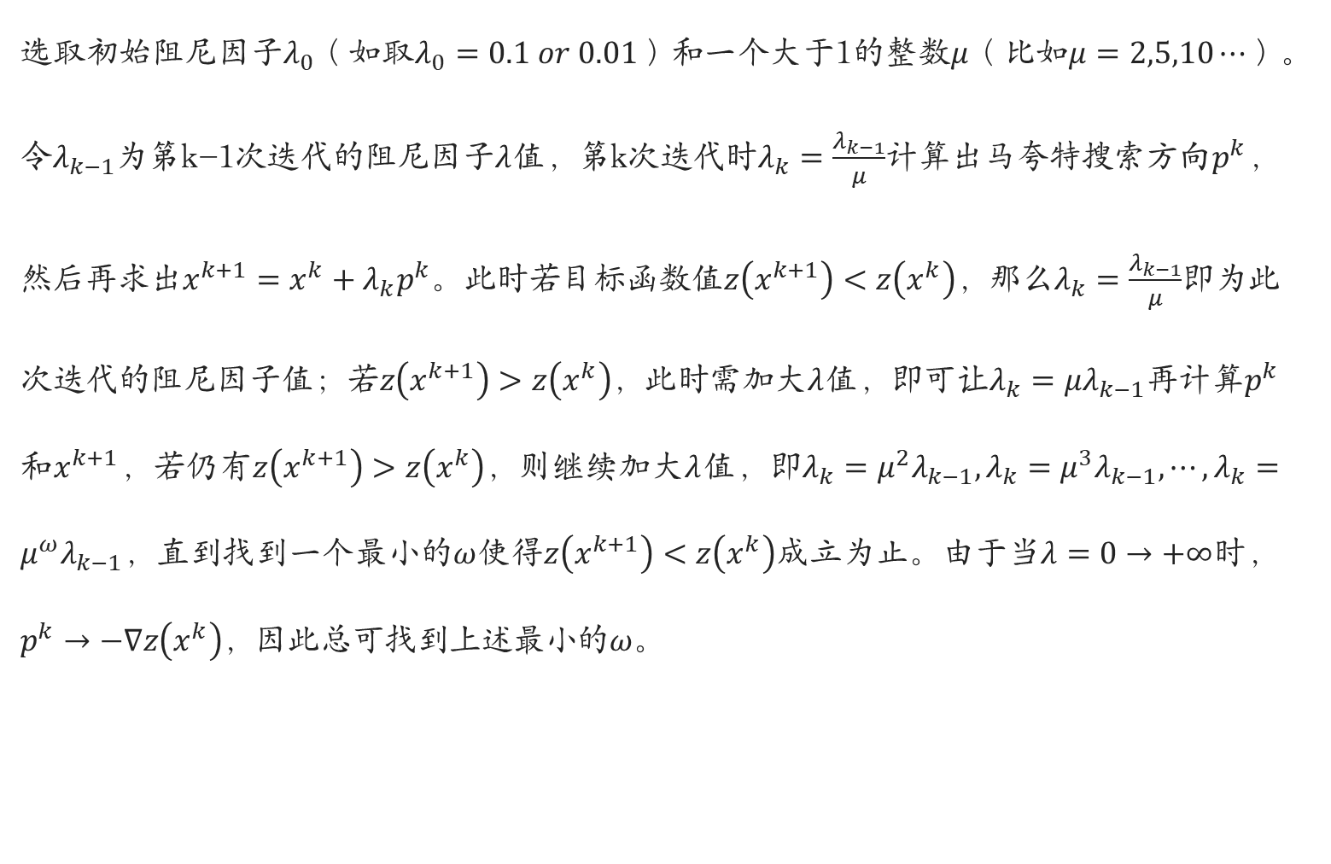
马夸特法(Marquardt method)
选取初始阻尼因子$λ_{0}$（如取$λ_{0}=0.1 or 0.01$）和一个大于1的整数$μ$（比如$μ=2,5,10⋯$）。令$λ_{k−1}$为第k-1次迭代的阻尼因子$λ$值，第k次迭代时$λ_{k}=\frac{λ_{k−1}}{μ}$计算出马夸特搜索方向$p^{k}$，然后再求出$x^{k+1}=x^{k}+λ_{k}p^{k}$。此时若目标函数值$z\left(x^{k+1}\right)<z\left(x^{k}\right)$，那么$λ_{k}=\frac{λ_{k−1}}{μ}$即为此次迭代的阻尼因子值；若$z\left(x^{k+1}\right)>z\left(x^{k}\right)$，此时需加大$λ$值，即可让$λ_{k}=μλ_{k−1}$再计算$p^{k}$和$x^{k+1}$，若仍有$z\left(x^{k+1}\right)>z\left(x^{k}\right)$，则继续加大$λ$值，即$λ_{k}=μ^{2}λ_{k−1}, λ_{k}=μ^{3}λ_{k−1}, ⋯, λ_{k}=μ^{ω}λ_{k−1}$，直到找到一个最小的$ω$使得$z\left(x^{k+1}\right)<z\left(x^{k}\right)$成立为止。由于当$λ=0→+∞$时，$p^{k}→−∇z\left(x^{k}\right)$，因此总可找到上述最小的$ω$。

Slide 26

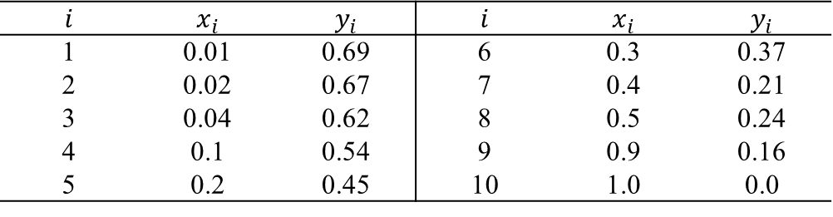
马夸特法(Marquardt method)
Case
吉利兰关联图数据如表所示
函数关系
$$f\left(x\right)=x_{1}+x_{2}m^{x_{3}} \left(x={\left(x_{1},x_{2},x_{3}\right)}^{T}\right)$$
则目标函数为
$$\min{z\left(x\right)}=\min{\sum_{l=1}^{k}{f_{l}^{2}\left(x\right)}}=\min{\sum_{l=1}^{10}{f_{l}^{2}\left(x\right)}}=\min{\sum_{l=1}^{10}{{\left[\left(x_{1}+x_{2}m_{i}^{x_{3}}\right)−y_{i}\right]}^{2}}}$$
函数$f_{l}\left(x\right)$的梯度
$$∇f_{l}\left(x\right)=\left[\begin{matrix}\frac{∂f_{l}\left(x\right)}{∂x_{1}} \\ \frac{∂f_{l}\left(x\right)}{∂x_{2}} \\ \frac{∂f_{l}\left(x\right)}{∂x_{3}}\end{matrix}\right]=\left[\begin{matrix}1 \\ m_{i}^{x_{3}} \\ x_{2}m_{i}^{x_{3}}\ln{m_{i}}\end{matrix}\right]$$
$$i$$ | $$x_{i}$$ | $$y_{i}$$ | $$i$$ | $$x_{i}$$ | $$y_{i}$$
1 | 0.01 | 0.69 | 6 | 0.3 | 0.37
2 | 0.02 | 0.67 | 7 | 0.4 | 0.21
3 | 0.04 | 0.62 | 8 | 0.5 | 0.24
4 | 0.1 | 0.54 | 9 | 0.9 | 0.16
5 | 0.2 | 0.45 | 10 | 1.0 | 0.0

Slide 27
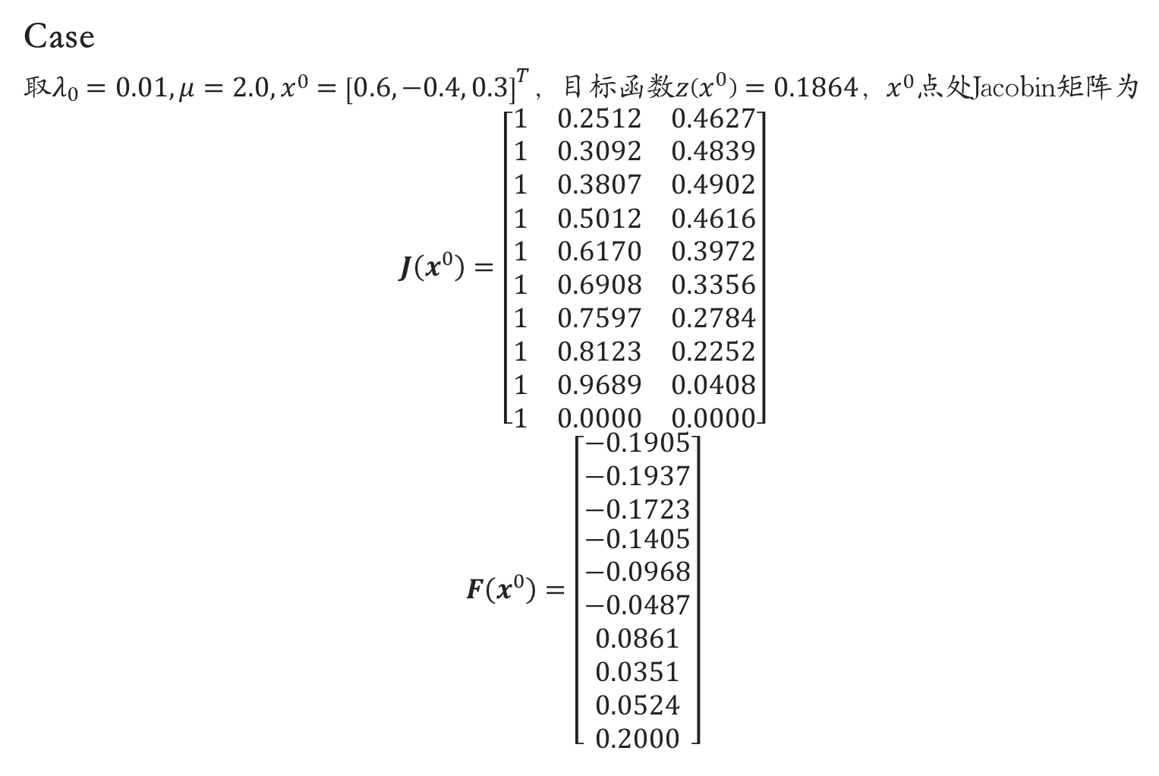
马夸特法(Marquardt method)
Case
取$λ_{0}=0.01, μ=2.0, x^{0}={\left[0.6,−0.4, 0.3\right]}^{T}$，目标函数$z\left(x^{0}\right)=0.1864$，$x^{0}$点处Jacobin矩阵为
$$J\left(x^{0}\right)=\left[\begin{aligned}\begin{matrix}1 & 0.2512 & 0.4627\end{matrix} \\ \begin{matrix}1 & 0.3092 & 0.4839\end{matrix} \\ \begin{matrix}1 & 0.3807 & 0.4902\end{matrix} \\ \begin{matrix}1 & 0.5012 & 0.4616\end{matrix} \\ \begin{matrix}1 & 0.6170 & 0.3972\end{matrix} \\ \begin{matrix}1 & 0.6908 & 0.3356\end{matrix} \\ \begin{matrix}1 & 0.7597 & 0.2784\end{matrix} \\ \begin{matrix}1 & 0.8123 & 0.2252\end{matrix} \\ \begin{matrix}1 & 0.9689 & 0.0408\end{matrix} \\ \begin{matrix}1 & 0.0000 & 0.0000\end{matrix}\end{aligned}\right]$$
$$F\left(x^{0}\right)=\left[\begin{aligned}\begin{matrix}−0.1905 \\ −0.1937 \\ −0.1723\end{matrix} \\ −0.1405 \\ −0.0968 \\ −0.0487 \\ 0.0861 \\ 0.0351 \\ 0.0524 \\ 0.2000\end{aligned}\right]$$

Slide 28
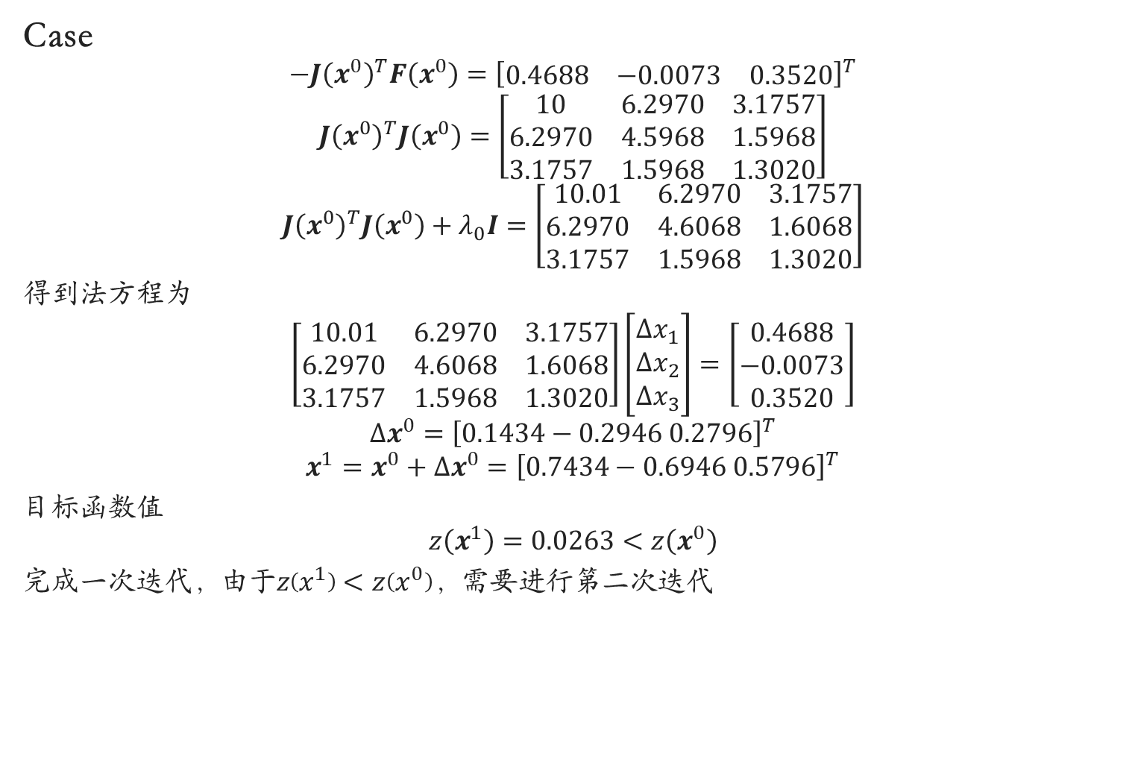
马夸特法(Marquardt method)
Case
$$−J{\left(x^{0}\right)}^{T}F\left(x^{0}\right)={\left[\begin{matrix}0.4688 & −0.0073 & 0.3520\end{matrix}\right]}^{T}$$
$$J{\left(x^{0}\right)}^{T}J\left(x^{0}\right)=\left[\begin{matrix}10 & 6.2970 & 3.1757 \\ 6.2970 & 4.5968 & 1.5968 \\ 3.1757 & 1.5968 & 1.3020\end{matrix}\right]$$
$$J{\left(x^{0}\right)}^{T}J\left(x^{0}\right)+λ_{0}I=\left[\begin{matrix}10.01 & 6.2970 & 3.1757 \\ 6.2970 & 4.6068 & 1.6068 \\ 3.1757 & 1.5968 & 1.3020\end{matrix}\right]$$
得到法方程为
$$\left[\begin{matrix}10.01 & 6.2970 & 3.1757 \\ 6.2970 & 4.6068 & 1.6068 \\ 3.1757 & 1.5968 & 1.3020\end{matrix}\right]\left[\begin{matrix}Δx_{1} \\ Δx_{2} \\ Δx_{3}\end{matrix}\right]=\left[\begin{matrix}0.4688 \\ −0.0073 \\ 0.3520\end{matrix}\right]$$
$$Δx^{0}={\left[0.1434−0.2946 0.2796\right]}^{T}$$
$$x^{1}=x^{0}+Δx^{0}={\left[0.7434−0.6946 0.5796\right]}^{T}$$
目标函数值
$$z\left(x^{1}\right)=0.0263<z\left(x^{0}\right)$$
完成一次迭代，由于$z\left(x^{1}\right)<z\left(x^{0}\right)$，需要进行第二次迭代

Slide 29

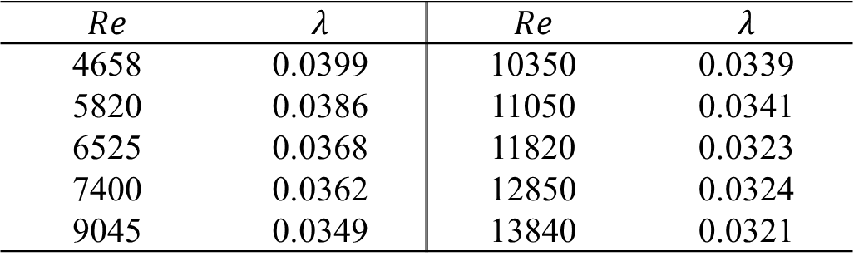
马夸特法(Marquardt method)
Ex
化工流体管路实验中摩擦阻力系数$λ$和雷诺数$Re$的实验数据如下标，已知阻力系数$λ$和雷诺数$Re$之间的函数关系为
$$λ=a{\left(Re\right)}^{b}+c$$
尝试
(1) 建立该非线性最小二乘问题的数学模型；
(2) 假设模型求解初始点为${\left(0.5,−0.1,0.001\right)}^{T}$，阻尼因子$λ_{0}=0.1$，利用MATLAB编程实现Marquardt算法对该问题的求解。
$$Re$$ | $$λ$$ | $$Re$$ | $$λ$$
4658 | 0.0399 | 10350 | 0.0339
5820 | 0.0386 | 11050 | 0.0341
6525 | 0.0368 | 11820 | 0.0323
7400 | 0.0362 | 12850 | 0.0324
9045 | 0.0349 | 13840 | 0.0321

